Slide 1
MODULE-1

Slide 2
Database Management System (DBMS)
Database Management System (DBMS)
Data base- Collection of interrelated data
DBMS-Set of programs to access the data
DBMS contains information about a particular enterprise
DBMS provides an environment that is both convenient and
efficient to use.
Database Applications:
Banking: all transactions
Airlines: reservations, schedules
Universities: registration, grades
Sales: customers, products, purchases
Manufacturing: production, inventory, orders, supply chain
Human resources: employee records, salaries, tax deductions
Databases touch all aspects of our lives

Slide 3
Drawbacks of using file systems to store data:
Data redundancy and inconsistency
✔ Multiple file formats, duplication of information in different files
Difficulty in accessing data
✔ Need to write a new program to carry out each new task
Data isolation — multiple files and formats
Integrity problems
✔ Integrity constraints (e.g. account balance > 0) become part of program code
✔ Hard to add new constraints or change existing ones

Slide 4
Atomicity of updates
✔ Failures may leave database in an inconsistent state with partial
updates carried out
✔ E.g. transfer of funds from one account to another should either
complete or not happen at all
Concurrent access by multiple users
✔ Concurrent accessed needed for performance
✔ Uncontrolled concurrent accesses can lead to inconsistencies
E.g. two people reading a balance and updating it at the same
time
Security problems
Database systems offer solutions to all the above problems

Slide 5

Example of a simple database

Slide 6
Main Characteristics of the Database Approach
Self-describing nature of a database system
Insulation between programs and data:
Data Abstraction:
Support of multiple views of the data:
Sharing of data and multi-user transaction processing:

Slide 7
Main Characteristics of the Database Approach
Self-describing nature of a database system:
the database system contains not only the database itself but also a complete definition or description of the database structure and constraints. This definition is stored in the system catalog
A DBMS catalog stores the description of a particular database (e.g. data structures and types)
The description is called meta-data.
This allows the DBMS software to work with different database applications.

Slide 8
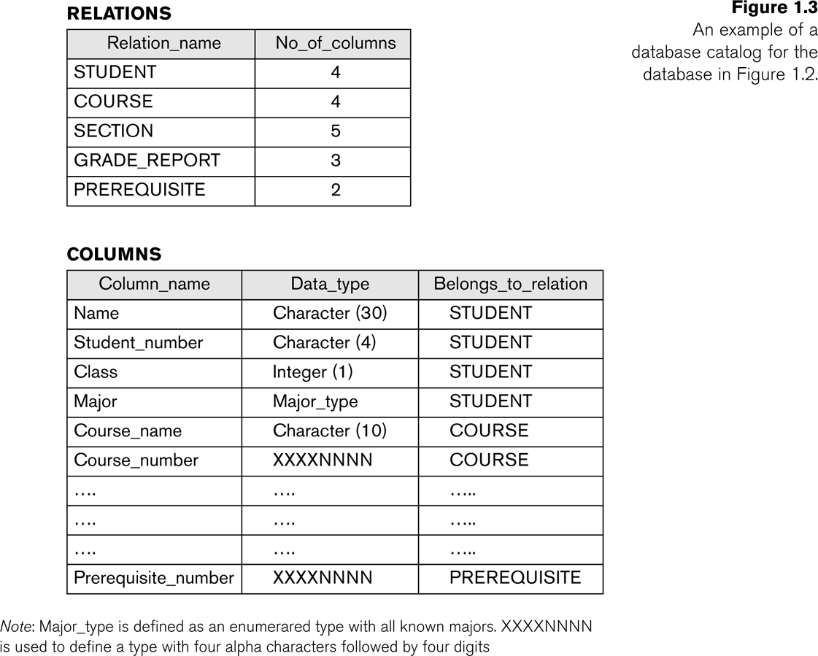
Example of a simplified database catalog

Slide 9
Main Characteristics of the Database Approach (continued)
2. Insulation between programs and data:
The structure of data files is stored in the DBMS catalog separately from the access programs.
Called program-data independence.
Allows changing data structures and storage organization without having to change the DBMS access programs.

Slide 10
Main Characteristics of the Database Approach (continued)
3. Data Abstraction:
A data model is used to hide storage details and present the users with a conceptual view of the database.
Programs refer to the data model constructs rather than data storage details
4. Support of multiple views of the data:
Each user may see a different view of the database, which describes only the data of interest to that user.

Slide 11
Main Characteristics of the Database Approach (continued)
5. Sharing of data and multi-user transaction processing:
Allowing a set of concurrent users to retrieve from and to update the database
Care is needed to avoid interferences
Concurrency control within the DBMS guarantees that each transaction is correctly executed or aborted
Recovery subsystem ensures each completed transaction has its effect permanently recorded in the database

Slide 12
Advantages of Using a DBMS
Controlling Redundancy
Restricting Unauthorized Access
Providing Persistent Storage for Program Objects and Data Structures
Permitting Inferencing and Actions Using Rules
Providing Multiple User Interfaces
Representing Complex Relationships Among Data
Enforcing Integrity Constraints
Providing Backup and Recovery

Slide 13
ABSTRACTION
Data abstraction-Representing relevant information and hiding details of data storage that are not needed by most data base users
Levels of Abstraction
Physical level:- describes how a record is stored.
Logical level:-describes data stored in database, and the relationships among the data
View level:- application programs hide details of data types.
Views can also hide information (e.g., salary) for security purposes.

Slide 14
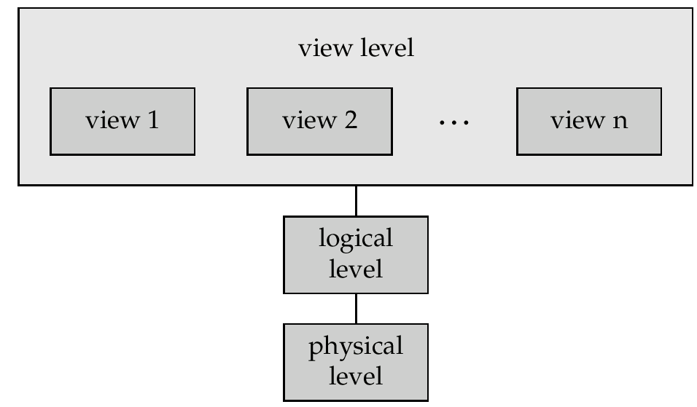
View of Data An architecture for a database system

Slide 15
Data Models
A collection of concepts for describing structure of a data base.
Structure of data base include
data types
data relationships
data constraints
Data models categories based on the concepts used
High level(conceptual)data model -provide concepts that are close to the way many users perceive data.ER diagram
Low level(physical) – how data is stored in the computer,for computer specialist not for end user.indexing,hashing
Representational(implementational)-provide concepts that may understood by end users.relational model(table)

Slide 16
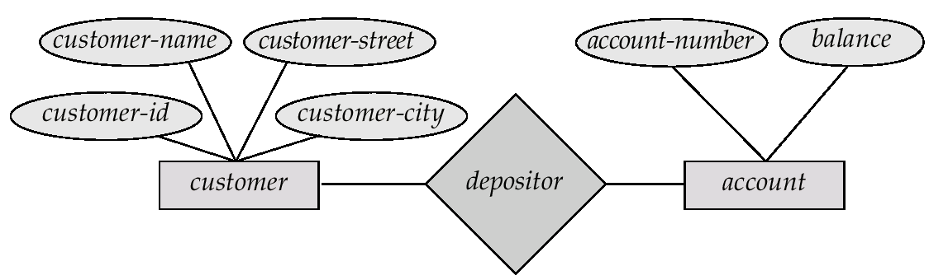
Entity-Relationship Model Example of schema in the entity-relationship model

Slide 17
Entity Relationship Model (Cont.)
E-R model of real world
Entities (objects)
✔ E.g. customers, accounts, bank branch
Relationships between entities
✔ E.g. Account A-101 is held by customer Johnson
✔ Relationship set depositor associates customers with accounts
Widely used for database design
Database design in E-R model usually converted to design in the
relational model (coming up next) which is used for storage and
processing

Slide 18
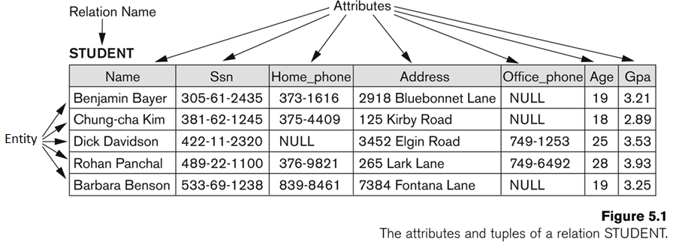
Example of a Relation

Slide 19
SCHEMA AND INSTANCE
Database Schema: The description of a database. Includes descriptions of the database structure and the constraints that should hold on the database.
Schema Diagram: A diagrammatic display of (some aspects of) a database schema.
Database Instance: The actual data stored in a database at a particular moment in time. Also called database state (or occurrence).

Slide 20
Database Schema Vs. Database State
Database State: Refers to the content of a database at a moment in time.
Initial Database State: Refers to the database when it is loaded
Distinction
The database schema changes very infrequently. The database state changes every time the database is updated.
Schema is also called intension, whereas state is called extension.

Slide 21

University Database

Slide 22
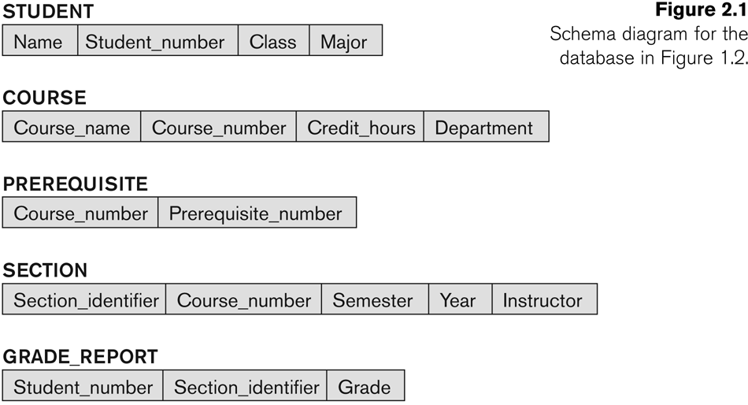
Example of a Database Schema

Slide 23
Three-Schema Architecture
Defines DBMS schemas at three levels:
Internal schema at the internal level to describe physical storage structures and access paths. Typically uses a physical data model.
Conceptual schema at the conceptual level to describe the structure and constraints for the whole database for a community of users. Uses a conceptual or an implementation data model.
External schemas at the external level to describe the various user views. Usually uses the same data model as the conceptual level.

Slide 24
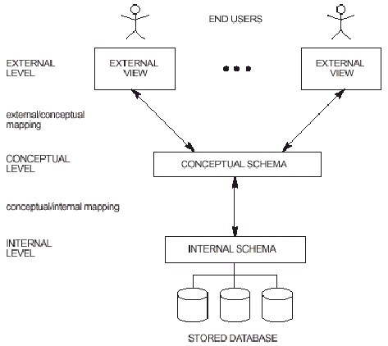

Slide 25
Mappings among schema levels are needed to transform requests and data. Programs refer to an external schema, and are mapped by the DBMS to the internal schema for execution.

Slide 26
Data Independence
Change schema at one level without changing next higher level
Logical Data Independence: The capacity to change the conceptual schema without having to change the external schemas and their application programs.
Physical Data Independence: The capacity to change the internal schema without having to change the conceptual schema.

Slide 27
DBMS LANGUAGES
Data Definition Language (DDL)
to Specify the database schema
E.g.create table account (account-number char(10),balance integer)
DDL compiler generates a set of tables stored in a data dictionary.
Data dictionary contains metadata (i.e., data about data) database schema
Storage and Definition language(SDL)
language in which the storage structure and access methods used by the database system are specified
Usually an extension of the data definition language
View Definition Language (VDL): is to specify user views

Slide 28
Data Manipulation Language (DML)
Language for accessing and manipulating the data organized by the appropriate data model
DML also known as query language(Query is a stmnt requesting retrieval of information)
Two classes of languages
Procedural – user specifies what data is required and how to get those data
Nonprocedural – user specifies what data is required without specifying how to get those data
SQL is the most widely used query language

Slide 29
Database Administrator
Coordinates all the activities of the database system;
the database administrator has a good understanding of the enterprise’s information resources and needs.
Database administrator's duties include:
Schema definition
Storage structure and access method definition
Schema and physical organization modification
Granting user authority to access the database
Specifying integrity constraints
Monitoring performance and responding to changes in requirements

Slide 30
DBMS Interfaces
User-friendly interfaces:
Menu-based, popular for browsing on the web.These interfaces present the user with lists of options, called menus, that lead the user through the formulation of a request.
Forms-based, . A forms-based interface displays a form to each user. Users can fill out all of the form entries to insert new data, or they fill out only certain entries, in which case the DBMS will retrieve matching data for the remaining entries

Slide 31
Graphics-based :(Point and Click, Drag and Drop etc.). A graphical interface (GUI) typically displays a schema to the user in diagrammatic form. The user can then specify a query by manipulating the diagram. In many cases, GUIs utilize both menus and forms. Most GUIs use a pointing device, such as a mouse, to pick certain parts of the displayed schema diagram.
Natural language: requests in written English
Interfaces for the DBA:
Creating accounts, granting authorizations
Setting system parameters
Changing schemas or access path

Slide 32
Data Modeling Using Entity-Relationship
E-R data model perceive real world as basic objects called Entities,relationship among these objects.
Basic concepts
Entity set – Set of entities of same type having same properties, e.g. customers, students
Attributes: common properties of the entities in a entity sets
Relationship – specify the relations among entities from two or more entity sets

Slide 33
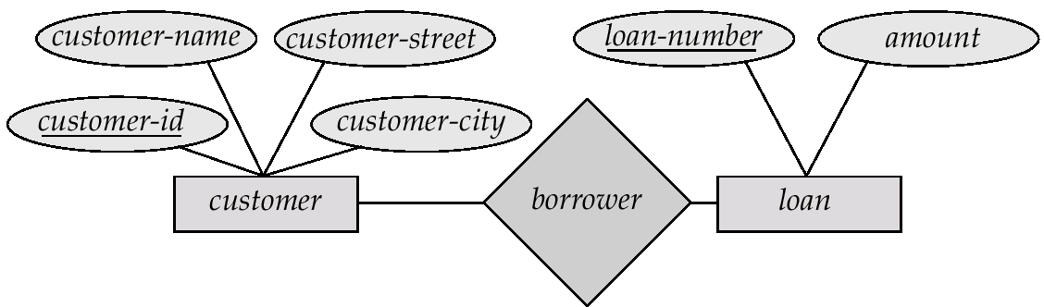
An Example

Slide 34
Attributes
Attributes may be
Simple,Composite
Single –valued,Multi-valued (double ellipse)
Stored –Derive d(dashed ellipse)
Simple or atomic:-attribute are not divided into subparts.represented by ellipse ex:sex,age
Composite:-can be divided into subparts
Ex:address,name,dob

Slide 35
Single-valued:-attributes having single value for particular entity.ex:dob,sex
Multi-valued:-attributes has set of values for specific entity.double ellipse
Ex:phno,email id
Derived attribute:-value for this attribute can be derived from values of other related attributes.ex:age

Slide 36
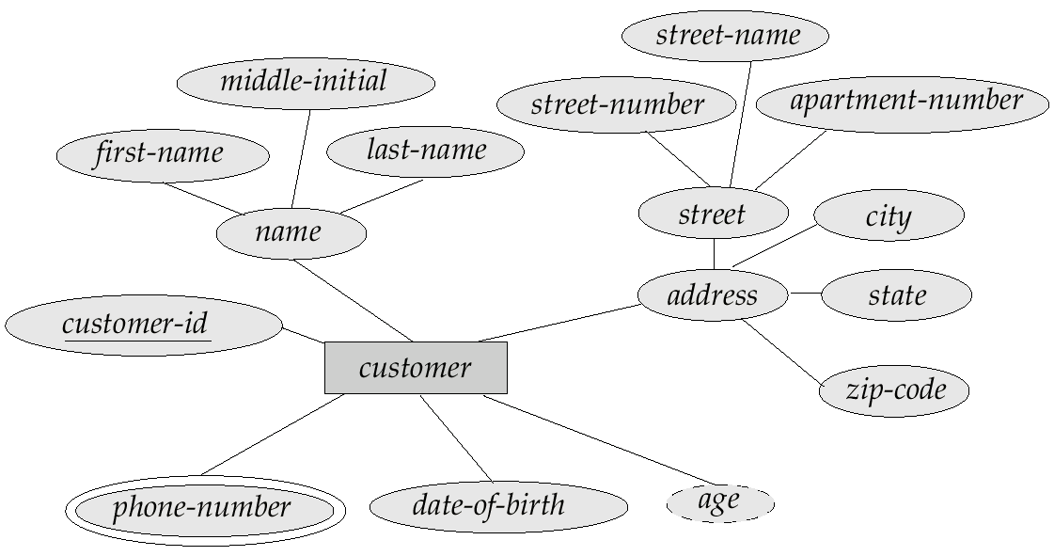
example

Slide 37
RELATIONSHIP
Relation ship-Is an association among several entities.
ex: Hayes is customer with loan number L-15
Relationship set-is a set of relationship of same type
ex-borrower is relationship set to denote association between customers and bank loan
The degree of a relationship = the number of entity sets that participate in the relationship
Mostly binary relationships
Sometimes more

Slide 38
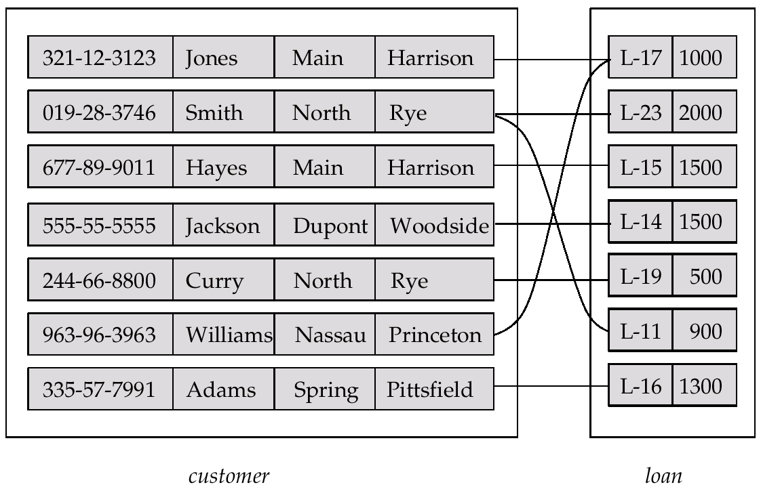
RELATIONSHIP

Slide 39
Mapping cardinality-
number of entities to which another entity can be associated via a relationship set .
1 –1:-An entity in A is associated with at most
one entity in B
1 – many:-an entity in A is associated with zero or more entities in B.An entity in B has at most one entity in A.
many – 1:- An entity in A is associated with at most
one entity in B. an entity in B is associated with zero or more(any) entities in A.
Many-many:-an entity in A is associated with zero or more entities in B. an entity in B is associated with zero or more entities in A.

Slide 40
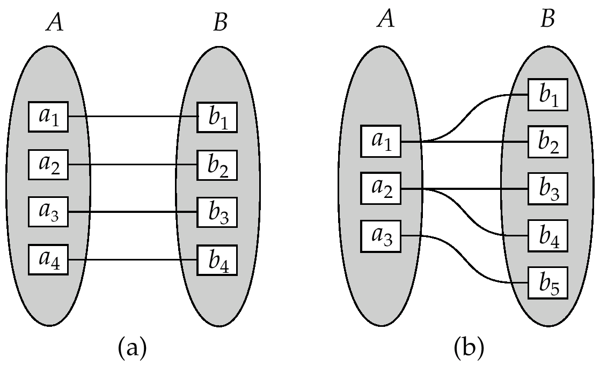
One-One and One-Many

Slide 41
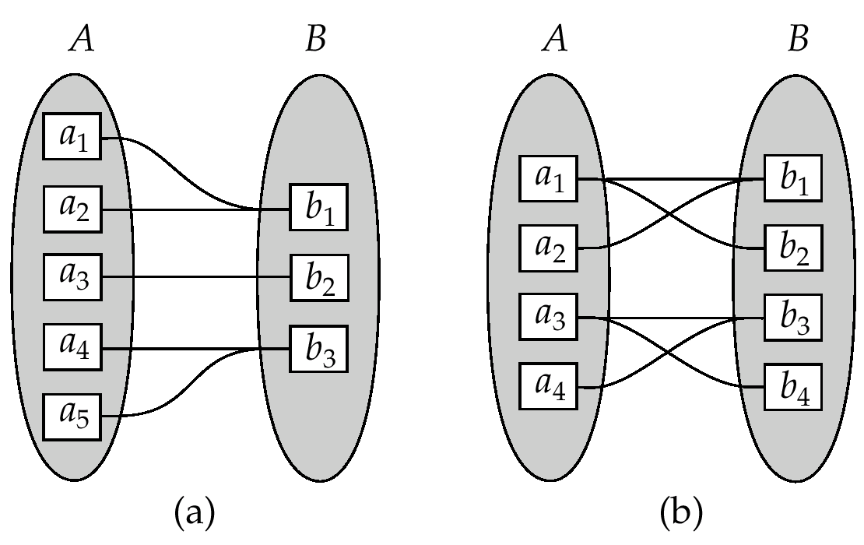
Many-one and many-many

Slide 42
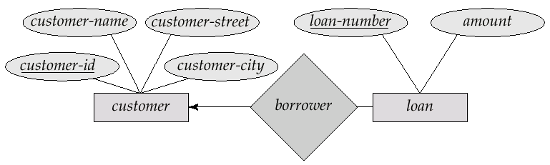
1- many

Slide 43

Many - 1

Slide 44

Many - many

Slide 45
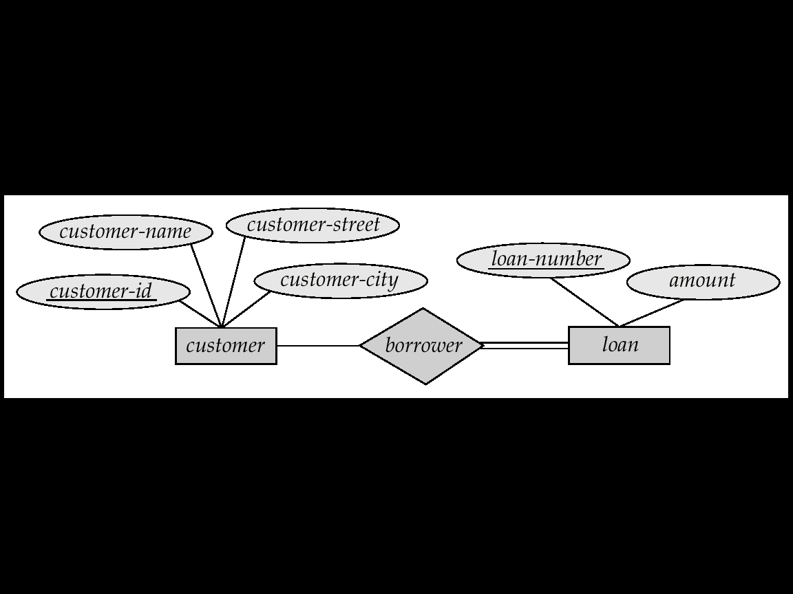
Total Participation
When we require all entities to participate in the relationship (total participation), we use double lines to specify
Ex:Every loan has to have at least one customer

Slide 46
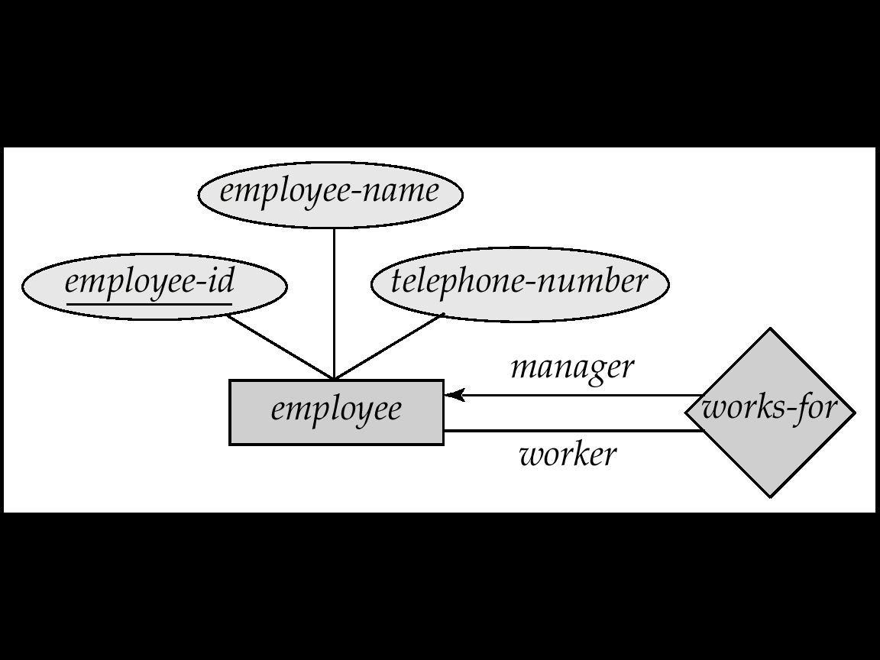
Self Relationship
Sometimes entities in a entity set may relate to other entities in the same set. Thus self relationship
Here employees mange some other employees
The labels “manger” and “worker” are called roles the self relationship

Slide 47
Partial participation
When we require some entities to participate in the relationship . we use single line to specify

Slide 48
Keys
Keys help to uniquely identify entities and relationship
A super key of an entity set is a set of one or more attributes whose values uniquely determine each entity.
Super key can be simple or composite
A relation can more than one superkey
ex:{customer-id}{customer-id,customer-name}
A candidate key of an entity set is a minimal super key.
Ex:{customer-id}{customer-name,customer-street}
Although several candidate keys may exist, one of the candidate keys is selected to be the primary key.
ex:{customer-id}

Slide 49
A Foreign key is used when we must represent the relationship between two tables and relations
A foreign key is an attribute (possibly composite) in a relation of a database that serves as the primary key of another relation in the same database
A Composite key is a primary key that consists of more than one attribute.
Here is a text description for four relations:
CUSTOMER(Customer_ID, Customer_Name, Address, City, State, Zip)
ORDER(Order_ID, Order_Date, Customer_ID)
ORDER_LINE(Order_ID, Product_ID, Quantity)
PRODUCT(Product_ID, Product_Description, Product_Finish, Standard_Price, On_Hand)

Slide 50
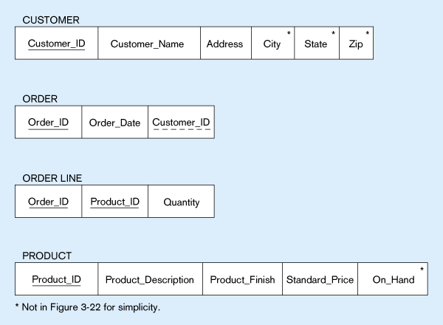
Primary Key
Foreign Key (implements 1:N relationship between customer and order)
Combined, these are a composite primary key (uniquely identifies the order line)…individually they are foreign keys (implement M:N relationship between order and product)

Slide 51
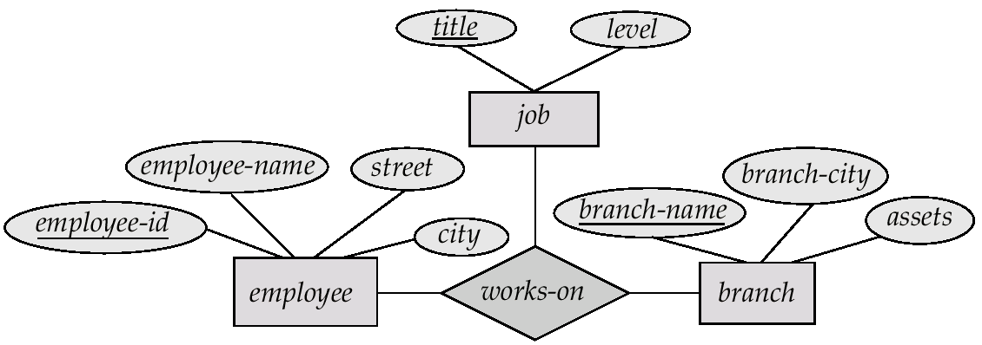
Ternary Relationship

Slide 52
Weak Entity Set
An entity set may not have sufficient attribute to form a primary key.
So depend on some other entity set(owner entity). They can be uniquely identified only if combined with another entity set. Such an entity is termed as weak entity set
An entity set that has primary key-strong entity
Descriminator of a weak entity set is used to uniquely identify each entity in weak entity set

Slide 53
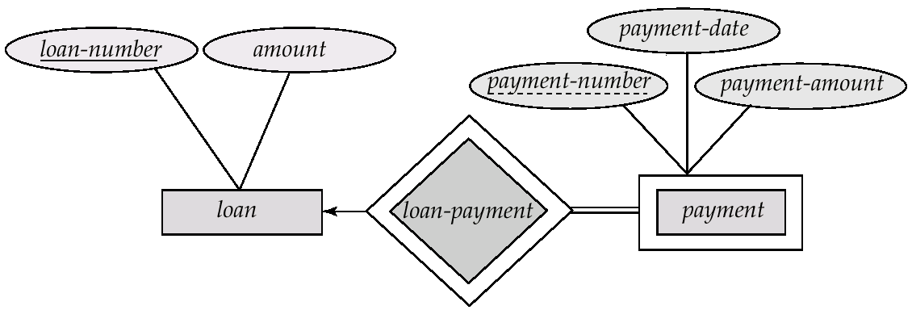
Weak Entity Set Notations
Double rectangles for weak entity set
Double diamond for weak entity relationship
Dashed underscore for discriminator or partial key
{payment-number,loan-number}-pk of weak entity

Slide 54
SUMMARY OF ER-DIAGRAM NOTATION FOR ER SCHEMAS
Symbol
Meaning
ENTITY TYPE
WEAK ENTITY TYPE
RELATIONSHIP TYPE
IDENTIFYING RELATIONSHIP TYPE
ATTRIBUTE
KEY ATTRIBUTE
MULTIVALUED ATTRIBUTE
COMPOSITE ATTRIBUTE
DERIVED ATTRIBUTE
TOTAL PARTICIPATION OF E₂ IN R
CARDINALITY RATIO 1:N FOR E₁:E₂ IN R
E₁
R
E₂
E₁
R
N
E₂

Slide 55
University ER Diagram
Degree
Major In
DName
DCode
OfficeNumber
Name
StudentID
SSN
Birth date
Department
OfficePhone
Sex
Student
Minor In
College
Class
Address
Offer
City
State
Zip
Grade_Report
CName
CourseDesc
Letter Grade
Instructor
Year
Course
GPA
CNumber
Belong_To
Credits
Numeric Grade
Section
SectionNumber
Semester

Slide 56
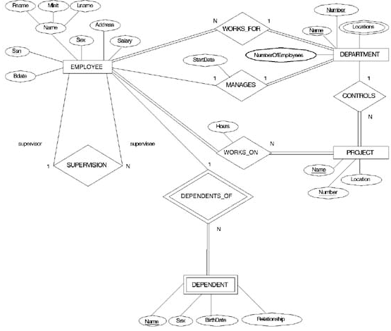
ER DIAGRAM – Entity Types are: EMPLOYEE, DEPARTMENT, PROJECT, DEPENDENT

Slide 57
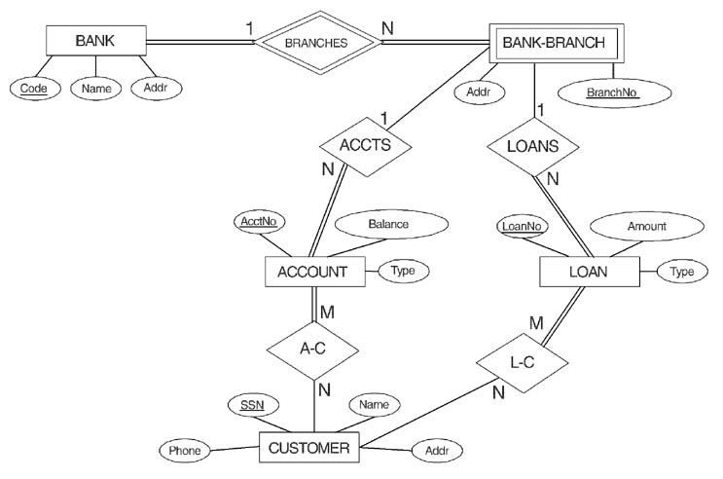
ER DIAGRAM FOR A BANK DATABASE
© The Benjamin/Cummings Publishing Company, Inc. 1994, Elmasri/Navathe, Fundamentals of Database Systems, Second Edition

Slide 58
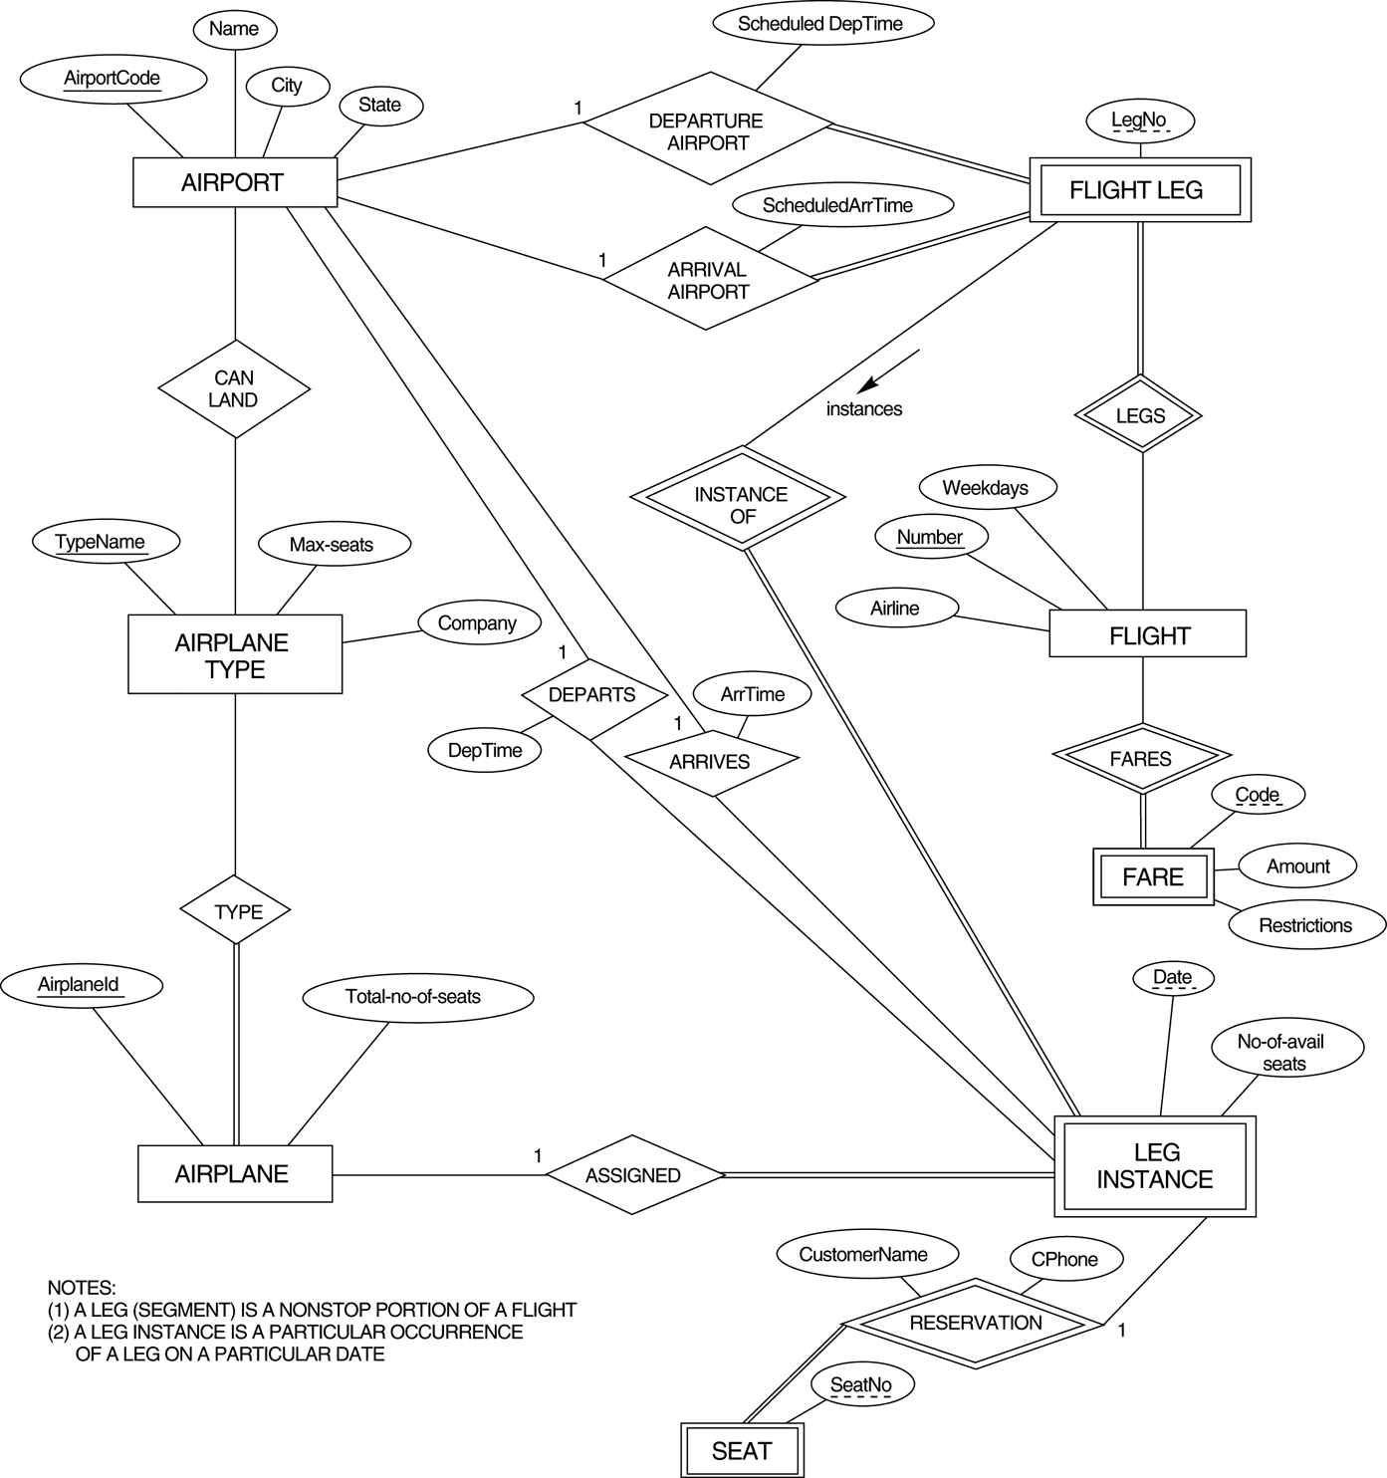
FIGURE 3.17 An ER diagram for an AIRLINE database schema.

Slide 59
ENHANCED ER(EER)MODEL
Includes all modeling concepts of basic ER
Additional concepts: subclasses/superclasses, specialization/generalization, categories, attribute inheritance
The resulting model is called the enhanced-ER or Extended ER (E2R or EER) model
It is used to model applications more completely and accurately if needed

Slide 60
Subclasses and Superclasses
An entity type may have additional meaningful subgroupings of its entities
Example: EMPLOYEE may be further grouped into SECRETARY, ENGINEER, MANAGER, TECHNICIAN, SALARIED_EMPLOYEE, HOURLY_EMPLOYEE,…
Each of these groupings is a subset of EMPLOYEE entities
Each is called a subclass of EMPLOYEE
EMPLOYEE is the superclass for each of these subclasses
These are called superclass/subclass relationships.

Slide 61
Specialization
Specialization is the process of defining a set of subclasses of an entity type
The set of subclasses is based upon some distinguishing characteristics of the entities in the superclass
Example: {SECRETARY, ENGINEER, TECHNICIAN} is a specialization of EMPLOYEE based upon job type.
May have several specializations of the same superclass
Example: Another specialization of EMPLOYEE based in method of pay is
{SALARIED_EMPLOYEE, HOURLY_EMPLOYEE}.

Slide 62
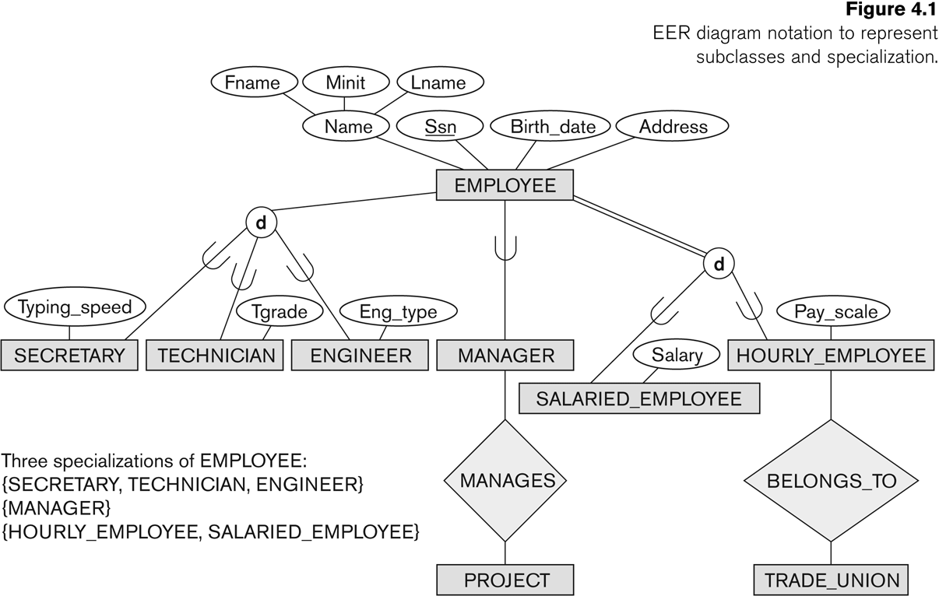
Specialization

Slide 63
Specialization
Superclass/subclass relationships and specialization can be diagrammatically represented in EER diagrams
The subset symbol on each line connecting a subclass to ϵ indicates the direction of the superclass/subclass relationship
Attributes of a subclass are called specific or local attributes.
For example, the attribute TypingSpeed of SECRETARY
The subclass can also participate in specific relationship types.
For example, a relationship BELONGS_TO of HOURLY_EMPLOYEE

Slide 64
Subclasses and Superclasses
These are called superclass/subclass relationships.
Example: EMPLOYEE/SECRETARY, EMPLOYEE/TECHNICIAN
These are also called IS-A relationships (SECRETARY IS-A EMPLOYEE, TECHNICIAN IS-A EMPLOYEE, …).

Slide 65
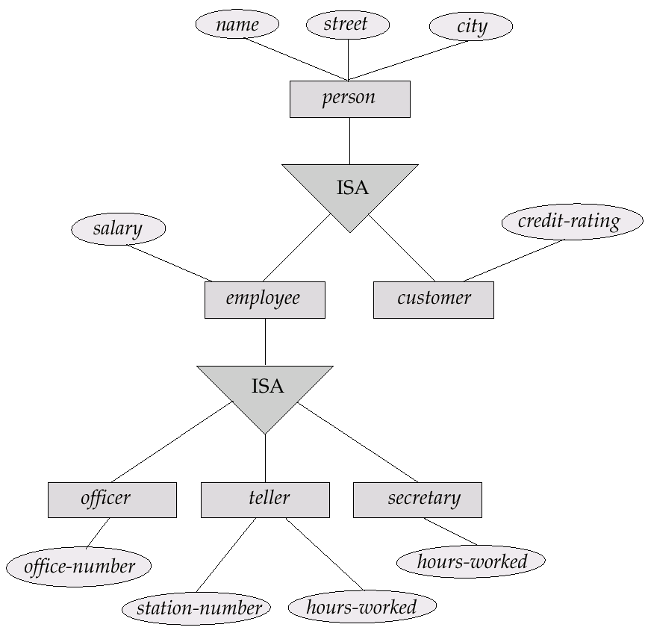
Subclasses and Superclasses

Slide 66
There are two major reasons for including class/subclass relationship and specialization in a data model:
1. Certain attributes may apply to some but not all entities of the superclass (secretary subclass has local attribute Typing speed where engineer has eng_type)
2. some relationship types may be participate in only by entities that are members of the subclass (Hourly_employees are related to Trade_union via belongs_to)

Slide 67
Attribute Inheritance in Superclass / Subclass Relationships
An entity that is member of a subclass inherits all attributes of the entity as a member of the superclass
It also inherits all relationships
Example:
SECRETARY (as well as TECHNICIAN and ENGINEER) inherit the attributes Name, SSN, …, from EMPLOYEE
Every SECRETARY entity will have values for the inherited attributes
Every SECRETARY entity will also keep all relationships

Slide 68
Generalization
Generalization is the reverse of the specialization process
Several classes with common features are generalized into a superclass;
original classes become its subclasses

Slide 69
Generalization
Example: CAR, TRUCK generalized into VEHICLE;
both CAR, TRUCK become subclasses of the superclass VEHICLE.
We can view {CAR, TRUCK} as a specialization of VEHICLE
Alternatively, we can view VEHICLE as a generalization of CAR and TRUCK

Slide 70
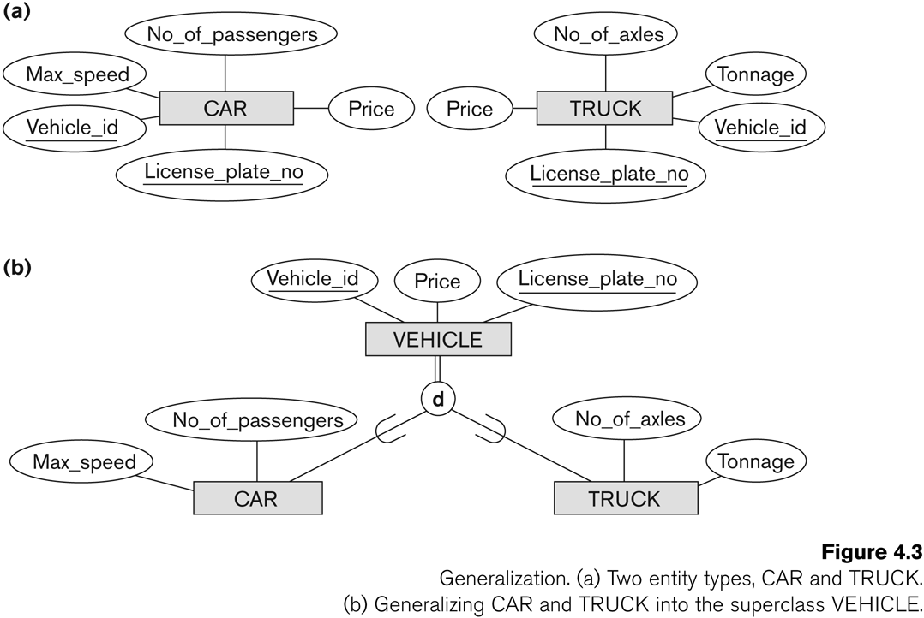

Slide 71
Constraints on Specialization and Generalization
Two basic constraints can apply to a specialization/generalization:
Disjointness Constraint:
Completeness Constraint:
Disjointness Constraint:
Specifies that the subclasses of the specialization must be disjoint: an entity can be a member of at most one of the subclasses of the specialization
Specified by d in EER diagram

Slide 72
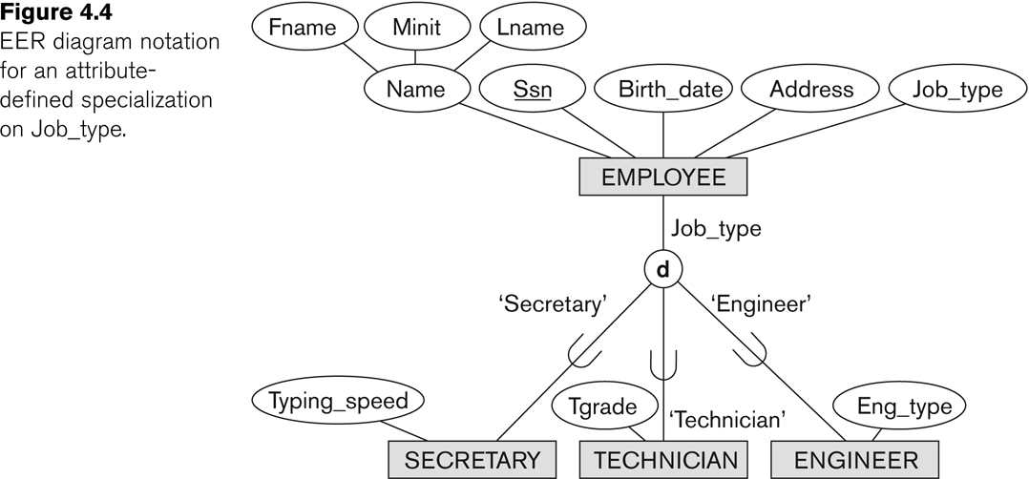

Slide 73
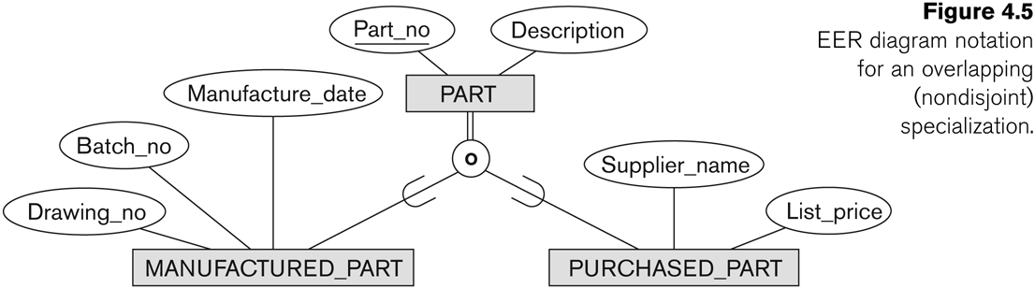
If not disjoint, specialization is overlapping
that is the same entity may be a member of more than one subclass of the specialization
Specified by o in EER diagram

Slide 74
Completeness Constraint:
Total specifies that every entity in the superclass must be a member of some subclass in the specialization/generalization
Shown in EER diagrams by a double line
Partial allows an entity not to belong to any of the subclasses
Shown in EER diagrams by a single line

Slide 75
Some general rules:
Deleting an entity from superclass implies that it is automatically deleted from all the subclasses to which it belongs
Inserting an entity in a superclass of a total specialization implies that the entity is mandatorily inserted in at least one of the subclasses of the specialization

Slide 76
Specialization/Generalization Hierarchies, Lattices
In a lattice or hierarchy, a subclass inherits attributes not only of its direct superclass, but also of all its predecessor superclasses
A subclass with more than one superclass is called a shared subclass
Can have specialization hierarchies or lattices, or generalization hierarchies or lattices
Leaf node is a class that has no subclasses of its own

Slide 77
Specialization/Generalization Hierarchies, Lattices
In specialization, start with an entity type and then define subclasses of the entity type by successive specialization (top down conceptual refinement process)
In generalization, start with many entity types and generalize those that have common properties (bottom up conceptual synthesis process)
In practice, the combination of two processes is employed

Slide 78
Specialization/Generalization Hierarchies, Lattices
A subclass may itself have further subclasses specified on it
Hierarchy has a constraint that every subclass has only one superclass (called single inheritance); this is basically a tree structure
In a lattice, a subclass can be subclass of more than one superclass (called multiple inheritance)

Slide 79
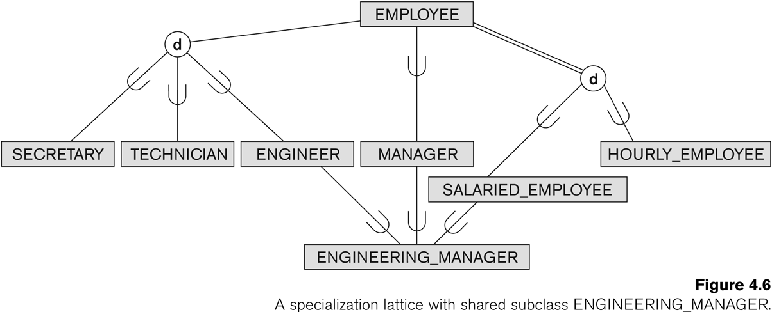
Shared Subclass “Engineering_Manager”

Slide 80
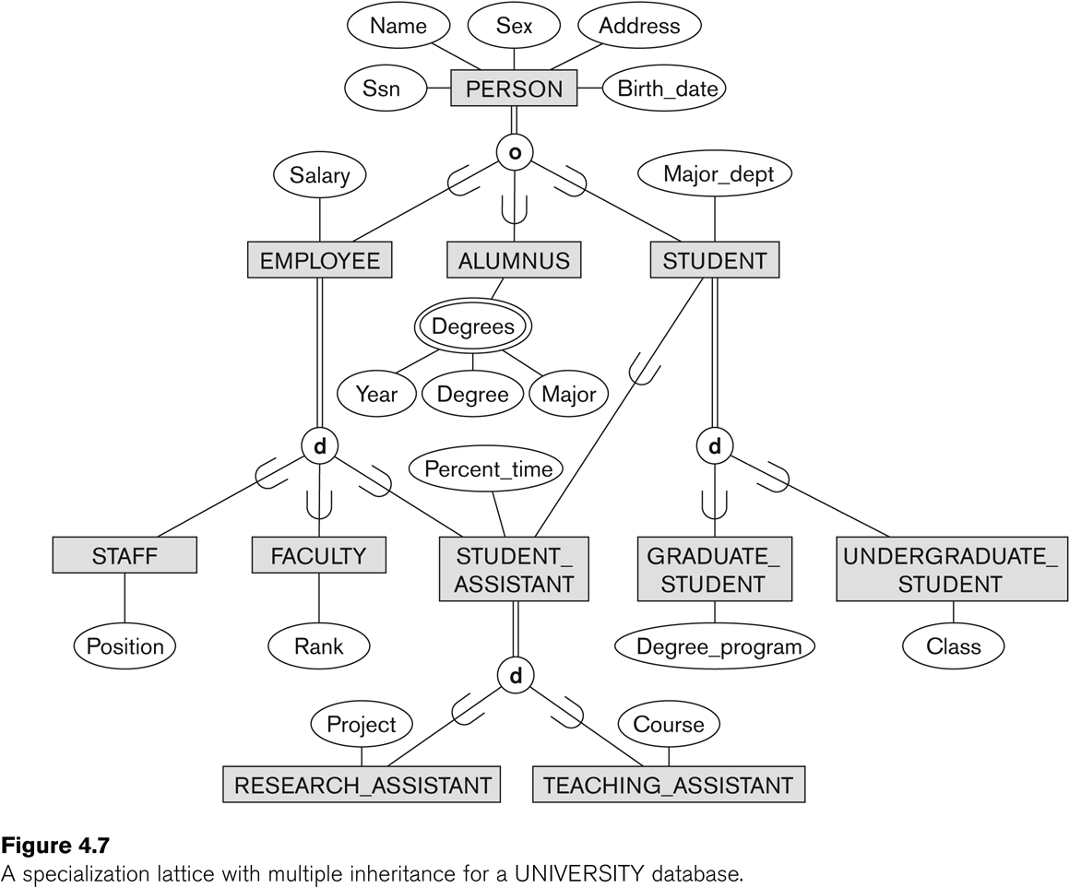
Specialization / Generalization Lattice Example (UNIVERSITY)

Slide 81
Union(category)
All of the superclass/subclass relationships we have seen so far origin from a single superclass
Sometimes we may need more than one superclass
In this case, the subclass will represent a collection of objects that is a subset of the UNION of distinct entity types
We call such a subclass a UNION TYPE

Slide 82
Example: In a database for vehicle registration, a vehicle owner can be a PERSON, a BANK (holding a lien on a vehicle) or a COMPANY.
A UNION type called OWNER is created to represent a subset of the union of the three superclasses COMPANY, BANK, and PERSON

Slide 83
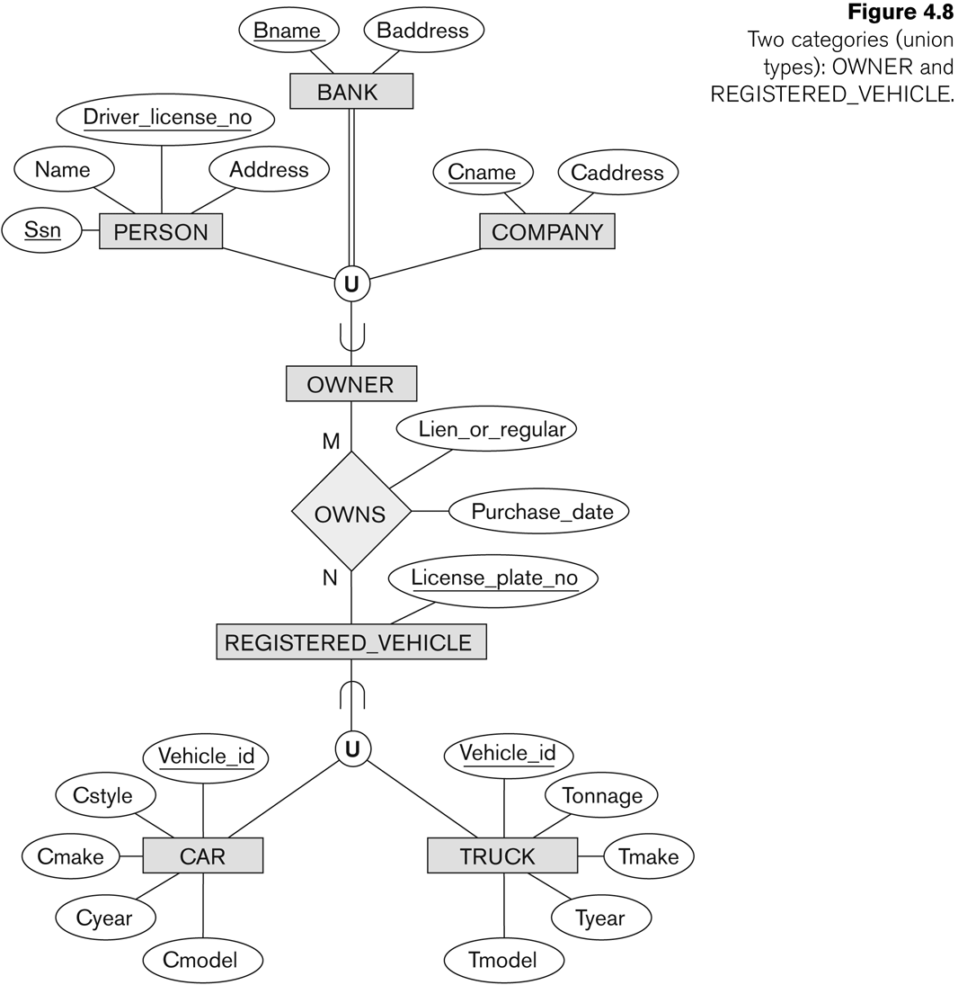
Two categories (UNION types): OWNER, REGISTERED_VEHICLE

Slide 84
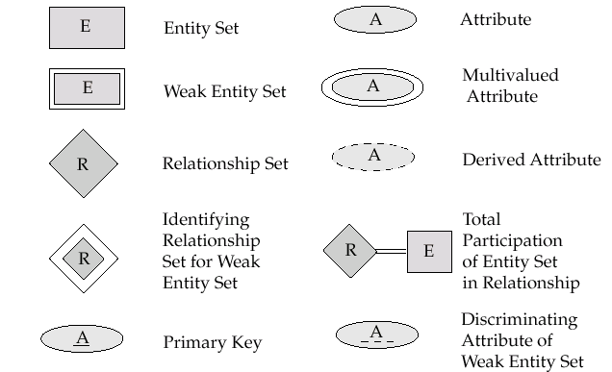
notations

Slide 85


Slide 86
MODULE-2

Slide 87
Databases are stored physically as files of records typically stored on magnetic disks.
• This chapter will deal with the organization of databases in storage and the techniques for accessing them efficiently
using various algorithms some of which require auxiliary data structures called Indexes.
Emphasize on search process ; deletion, update, and insertion issues will not be covered.

Slide 88
Memory Hierarchies and Storage Devices (1/6)
Primary storage
This category includes storage media that can be operated on directly by the computer CPU.
Primary storage usually provides fast access to data but is of limited storage capacity.
Secondary storage
The secondary storage devices usually have a larger capacity, cost less, and provide slower access to data than do primary storage devices.
Data in secondary storage cannot be processed directly by the CPU; it must first be copied into primary storage.

Slide 89
Memory Hierarchies and Storage Devices (2/6)
Primary storage
Cache memory
Static RAM
Main memory
DRAM
Advantage
Low cost
Drawbacks
Volatility
Lower speed compared with static RAM

Slide 90
Memory Hierarchies and Storage Devices (3/6)
Main memory databases
In some cases, entire databases can be kept in main memory (with a backup copy on magnetic disk).
These are particularly useful in real-time applications that require extremely fast response times.

Slide 91
Memory Hierarchies and Storage Devices (4/6)
Flash memory
Another form of memory between DRAM and magnetic disk storage.
Using EEPROM (Electrically Erasable Programmable Read-Only Memory) technology.
Advantages
Nonvolatile
Fast access speed
Disadvantage
An entire block must be erased and written over at a time.

Slide 92
Memory Hierarchies and Storage Devices (5/6)
Optical storage
CD-ROM
Contains prerecorded data that cannot be overwritten.
Holds about half a gigabyte of data per disk and last much longer than magnetic disks.
WORM (Write-Once-Read-Many)
Allows data to be written once and read any number of times without the possibility of erasing.
Optical juke box memories
Use an array of CD-ROM platters, which are loaded onto drives on demand.
Although optical juke boxes have capacities in the hundreds of gigabytes, their retrieval times are in the hundreds of milliseconds, quite a bit slower than magnetic disks.
DVD (Digital Video Disk)
Allows four to fifteen gigabytes of storage per disk.

Slide 93
Memory Hierarchies and Storage Devices (6/6)
Magnetic tapes are used for archiving and backup storage of data.
Tape jukeboxes—which contain a bank of tapes that are catalogued and can be automatically loaded onto tape drives—are becoming popular as tertiary storage to hold terabytes of data.

Slide 94
Storage of Databases (1/5)
Most databases are stored permanently (or persistently) on magnetic disk secondary storage, for the following reasons:
Generally, databases are too large to fit entirely in main memory.
The circumstances that cause permanent loss of stored data arise less frequently for disk secondary storage than for primary storage.
The cost of storage per unit of data is an order of magnitude less for disk than for primary storage.

Slide 95
Storage of Databases (2/5)
The techniques used to store large amounts of structured data on disk are important for database designers, the DBA, and implementers of a DBMS.
Database designers and the DBA must know the advantages and disadvantages of each storage technique when they design, implement, and operate a database on a specific DBMS.
Physical database design
DBMS system implementers must study data organization techniques so that they can implement them efficiently and thus provide the DBA and users of the DBMS with sufficient options.

Slide 96
Storage of Databases (3/5)
Typical database applications need only a small portion of the database at a time for processing.
Whenever a certain portion of the data is needed, it must be located on disk, copied to main memory for processing, and then rewritten to the disk if the data is changed.
The data stored on disk is organized as files of records.

Slide 97
Storage of Databases (4/5)
Primary file organizations determine how the records of a file are physically placed on the disk, and hence how the records can be accessed.
A heap file (or unordered file) places the records on disk in no particular order by appending new records at the end of the file.
A sorted file (or sequential file) keeps the records ordered by the value of a particular field (called the sort key).
A hashed file uses a hash function applied to a particular field (called the hash key) to determine a record’s placement on disk.
B-trees use tree structures.

Slide 98
Storage of Databases (5/5)
A secondary organization or auxiliary access structure allows efficient access to the records of a file based on alternate fields than those that have been used for the primary file organization.

Slide 99
Secondary Storage Devices

Slide 100
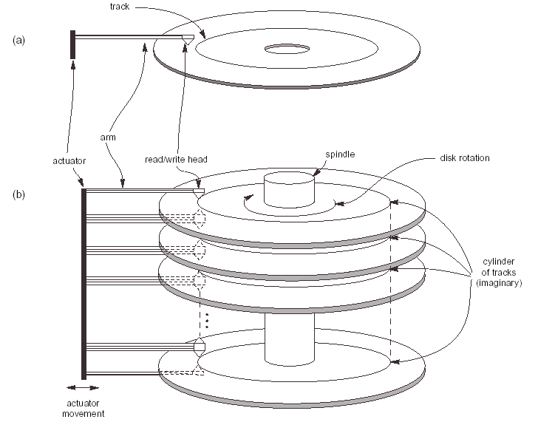

Slide 101
Hardware Description of Disk Devices (1/8)
A disk is single-sided if it stores information on only one of its surfaces and double-sided if both surfaces are used.
To increase storage capacity, disks are assembled into a disk pack, which may include many disks and hence many surfaces.
Information is stored on a disk surface in concentric circles of small width, each having a distinct diameter. Each circle is called a track.
For disk packs, the tracks with the same diameter on the various surfaces are called a cylinder because of the shape they would form if connected in space.

Slide 102
Hardware Description of Disk Devices (2/8)
Because a track usually contains a large amount of information, it is divided into smaller sectors.
The division of a track into sectors is hard-coded on the disk surface and cannot be changed.
One type of sector organization calls a portion of a track that subtends a fixed angle at the center as a sector.
Several other sector organizations are possible, one of which is to have the sectors subtend smaller angles at the center as one moves away, thus maintaining a uniform density of recording.
Not all disks have their tracks divided into sectors.

Slide 103
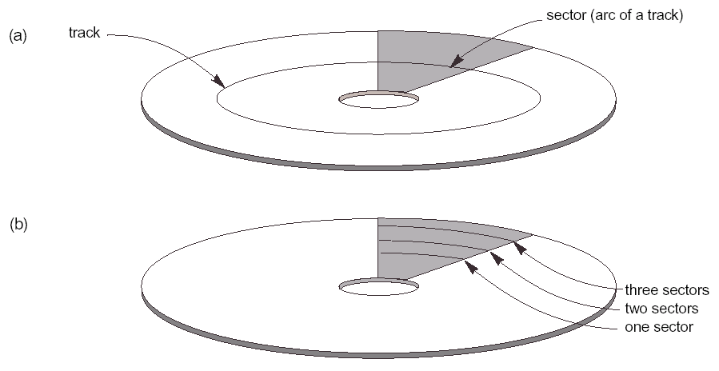

Slide 104
Hardware Description of Disk Devices (3/8)
The division of a track into equal-sized disk blocks (or pages) is set by the operating system during disk formatting (or initialization).
Block size is fixed during initialization and cannot be changed dynamically.
A disk with hard-coded sectors often has the sectors subdivided into blocks during initialization.
Blocks are separated by fixed-size interblock gaps, which include specially coded control information written during disk initialization.

Slide 105
Hardware Description of Disk Devices (4/8)
Transfer of data between main memory and disk takes place in units of disk blocks.
The hardware address of a block—a combination of a surface number, track number (within the surface), and block number (within the track)—is supplied to the disk input/output (I/O) hardware.
The address of a buffer—a contiguous reserved area in main storage that holds one block—is also provided.
For a read command, the block from disk is copied into the buffer; whereas for a write command, the contents of the buffer are copied into the disk block.
Sometimes several contiguous blocks, called a cluster, may be transferred as a unit.

Slide 106
Hardware Description of Disk Devices (5/8)
The actual hardware mechanism that reads or writes a block is the disk read/write head, which is part of a system called a disk drive.
A disk or disk pack is mounted in the disk drive, which includes a motor that rotates the disks.
A read/write head includes an electronic component attached to a mechanical arm.
Disk packs with multiple surfaces are controlled by several read/write heads—one for each surface.
All arms are connected to an actuator attached to another electrical motor, which moves the read/write heads in unison and positions them precisely over the cylinder of tracks specified in a block address.

Slide 107
Hardware Description of Disk Devices (6/8)
Disk drives for hard disks rotate the disk pack continuously at a constant speed.
Once the read/write head is positioned on the right track and the block specified in the block address moves under the read/write head, the electronic component of the read/write head is activated to transfer the data.
Some disk units have fixed read/write heads, with as many heads as there are tracks. These are called fixed-head disks, whereas disk units with an actuator are called movable-head disks.

Slide 108
Hardware Description of Disk Devices (7/8)
A disk controller, typically embedded in the disk drive, controls the disk drive and interfaces it to the computer system.
The controller accepts high-level I/O commands and takes appropriate action to position the arm and causes the read/write action to take place.
The total time needed to locate and transfer an arbitrary block, given its address, is the sum of the seek time, rotational delay, and block transfer time.

Slide 109
Hardware Description of Disk Devices (8/8)
The time needed to locate and transfer a disk block is in the order of milliseconds.
Locating data on disk is a major bottleneck in database applications.
The file structures attempt to minimize the number of block transfers needed to locate and transfer the required data from disk to main memory.

Slide 110
Magnetic Tape Storage Devices (1/3)
Magnetic tapes are sequential access devices; to access the n^{th} block on tape, we must first scan over the preceding n - 1 blocks.
Data is stored on reels of high-capacity magnetic tape, somewhat similar to audio or video tapes.
A tape drive is required to read the data from or to write the data to a tape reel.

Slide 111
Magnetic Tape Storage Devices (2/3)
A read/write head is used to read or write data on tape.
Data records on tape are also stored in blocks—although the blocks may be substantially larger than those for disks, and interblock gaps are also quite large.

Slide 112
Magnetic Tape Storage Devices (3/3)
Tape access is slow and tapes are not used to store on-line data, except for some specialized applications.
Tapes serve a very important function—that of backing up the database.
Tapes can also be used to store excessively large database files.
Finally, database files that are seldom used or outdated but are required for historical record keeping can be archived on tape.

Slide 113
Parallelizing Disk Access Using RAID Technology

Slide 114
With the exponential growth in the performance and capacity of semiconductor devices and memories, faster microprocessors with larger and larger primary memories are continually becoming available.
To match this growth, it is natural to expect that secondary storage technology must also take steps to keep up in performance and reliability with processor technology.

Slide 115
A major advance in secondary storage technology is represented by the development of RAID, which originally stood for Redundant Arrays of Inexpensive Disks.
Lately, the "I" in RAID is said to stand for Independent.

Slide 116
The main goal of RAID is to even out the widely different rates of performance improvement of disks against those in memory and microprocessors.
A concept called data striping is used, which utilizes parallelism to improve disk performance.
Data striping distributes data transparently over multiple disks to make them appear as a single large, fast disk.
Striping improves overall I/O performance by allowing multiple I/Os to be serviced in parallel, thus providing high overall transfer rates.
Data striping also accomplishes load balancing among disks.
Moreover, by storing redundant information on disks using parity or some other error correction code, reliability can be improved.

Slide 117
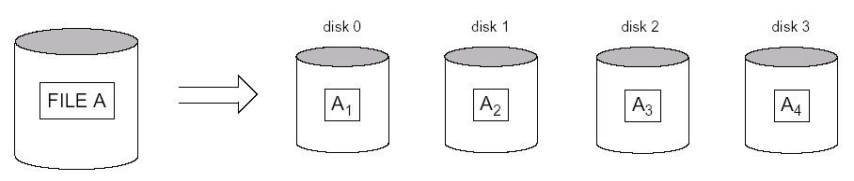

Slide 118
Improving Reliability with RAID (1/3)
For an array of n disks, the likelihood of failure is n times as much as that for one disk.
Keeping a single copy of data in such an array of disks will cause a significant loss of reliability.
An obvious solution is to employ redundancy of data so that disk failures can be tolerated.
The disadvantages are many: additional I/O operations for write, extra computation to maintain redundancy and to do recovery from errors, and additional disk capacity to store redundant information.

Slide 119
Improving Reliability with RAID (2/3)
One technique for introducing redundancy is called mirroring or shadowing.
Data is written redundantly to two identical physical disks that are treated as one logical disk.
When data is read, it can be retrieved from the disk with shorter queuing, seek, and rotational delays.
If a disk fails, the other disk is used until the first is repaired.
Disk mirroring also doubles the rate at which read requests are handled, since a read can go to either disk.
The transfer rate of each read, however, remains the same as that for a single disk.

Slide 120
Improving Reliability with RAID (3/3)
Another solution to the problem of reliability is to store extra information that is not normally needed but that can be used to reconstruct the lost information in case of disk failure.
The incorporation of redundancy must consider two problems: (1) selecting a technique for computing the redundant information, and (2) selecting a method of distributing the redundant information across the disk array.
The first problem is addressed by using error correcting codes involving parity bits, or specialized codes such as Hamming codes.
For the second problem, the two major approaches are either to store the redundant information on a small number of disks or to distribute it uniformly across all disks.

Slide 121
Improving Performance with RAID (1/2)
The disk arrays employ the technique of data striping to achieve higher transfer rates.
Disk striping may be applied at a finer granularity by breaking up a byte of data into bits and spreading the bits to different disks.
Bit-level data striping can be generalized to a number of disks that is either a multiple or a factor of eight.
In a m-disk array, bit n goes to the disk which is (n mod m).
Each disk participates in each I/O request and the total amount of data read per request is m times as much.

Slide 122
Improving Performance with RAID (2/2)
The granularity of data interleaving can be higher than a bit; for example, blocks of a file can be striped across disks, giving rise to block-level striping.
With block-level striping, multiple independent requests that access single blocks (small requests) can be serviced in parallel by separate disks, thus decreasing the queuing time of I/O requests.
Requests that access multiple blocks (large requests) can be parallelized, thus reducing their response time.
In general, the more the number of disks in an array, the larger the potential performance benefit.

Slide 123
RAID Organizations and Levels (1/4)
Different RAID organizations were defined based on different combinations of the two factors of granularity of data interleaving (striping) and pattern used to compute redundant information.
In the initial proposal, levels 1 through 5 of RAID were proposed, and two additional levels—0 and 6—were added later.

Slide 124
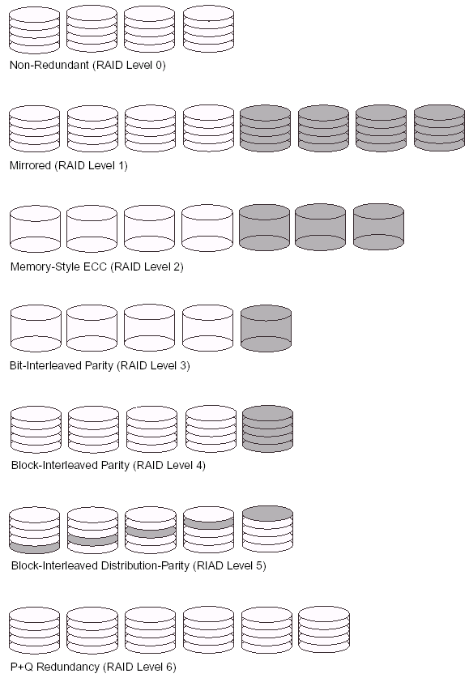

Slide 125
RAID Organizations and Levels (2/4)
RAID level 0 has no redundant data and hence has the best write performance since updates do not have to be duplicated.
However, its read performance is not as good as RAID level 1, which uses mirrored disks.
In the latter, performance improvement is possible by scheduling a read request to the disk with shortest expected seek and rotational delay.
RAID level 2 uses memory-style redundancy by using Hamming codes, which contain parity bits for distinct overlapping subsets of components.
Level 2 includes both error detection and correction, although detection is generally not required because broken disks identify themselves.

Slide 126
RAID Organizations and Levels (3/4)
RAID level 3 uses a single parity disk relying on the disk controller to figure out which disk has failed.
Levels 4 and 5 use block-level data striping, with level 5 distributing data and parity information across all disks.
Finally, RAID level 6 applies the so-called P + Q redundancy scheme using Reed-Soloman codes to protect against up to two disk failures by using just two redundant disks.

Slide 127
RAID Organizations and Levels (4/4)
Rebuilding in case of disk failure is easiest for RAID level 1.
Other levels require the reconstruction of a failed disk by reading multiple disks.
Level 1 is used for critical applications such as storing logs of transactions.
Levels 3 and 5 are preferred for large volume storage, with level 3 providing higher transfer rates.

Slide 128
Storage Medium
• Primary Storage
– Main memory, smaller but faster cache memories.
– Fast access to data but is of limited storage capacity
– Can be operated on directly by the CPU
• Secondary Storage
– Magnetic disks, optical disks and tapes
– Larger capacity and less cost
– Slower access to data
– Data cannot be processed directly by CPU
Magnetic Disks
– Secondary storage.
– Transfer of data between main memory and disk takes place in units of disk blocks: blocks
units of data transfer and data allcation.
– For read command: the block from disk is copied into the buffer
– For write command: the contents of the buffer are copied into the disk block

Slide 129
Placing File Records on Disk
Records and Record Types
Files, Fixed-Length Records, and Variable-
Length Records
Record Blocking and Spanned Versus
Unspanned Records
Allocating File Blocks on Disk

Slide 130
Records and Record Types
Data is usually stored in the form of records. Each record consists of a collection of related data values or items.
Records usually describe entities and their attributes.
Ex:employee
A collection of field names and their corresponding data types constitutes a record type or record format definition.
A datatype, associated with each field, specifies the types of values a field can take.

Slide 131
Files, Fixed-Length Records,and Variable-Length Records
A file is a sequence of records.
In many cases, all records in a file are of the same record type.
If every record in the file has exactly the same size (in bytes), the file is said to be made up of fixed-length records.
If different records in the file have different sizes, the file is said to be made up of variable-length records.

Slide 132
A file may have variable-length records for several reasons:
■ The file records are of the same record type, but one or more of the fields are of varying size (variable-length fields). For example, the Name field of EMPLOYEE can be a variable-length field.
■ The file records are of the same record type, but one or more of the fields may have multiple values for individual records; such a field is called a repeating field and a group of values for the field is often called a repeating group.

Slide 133
■ The file records are of the same record type, but one or more of the fields are optional; that is, they may have values for some but not all of the file records(optional fields).
■ The file contains records of different record types and hence of varying size

Slide 134
Record Blocking and Spanned versus Unspanned Records
The records of a file must be allocated to disk blocks because a block is the unit of data transfer between disk and memory
For a file of fixed-length records of size R bytes, with B ≥ R, we can fit bfr =⎣B/R⎦ records per block.
The value bfr is called the blocking factor for the file.
In general, R may not divide B exactly, so we have some unused space in each block= B − (bfr * R) bytes

Slide 135
To utilize this unused space, we can store part of a record on one block and the rest on another.
A pointer at the end of the first block points to the block containing the remainder of the record in case it is not the next consecutive block on disk.
This organization is called spanned because records can span more than one block.
Whenever a record is larger than a block, we must use a spanned organization.

Slide 136
If records are not allowed to cross block boundaries, the organization is called unspanned.
For variable-length records, either a spanned or an unspanned organization can be used.
If the average record is large, it is advantageous to use spanning to reduce the lost space in each block.

Slide 137
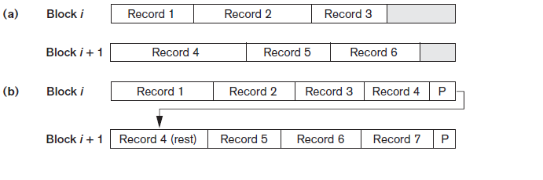
Types of record organization. (a) Unspanned.(b) Spanned.

Slide 138
Allocating File Blocks on Disk
There are several standard techniques for allocating the blocks of a file on disk.
contiguous allocation:the file blocks are allocated to consecutive disk blocks.
linked allocation:each file block contains a pointer to the next file block. This makes it easy to expand the file but makes it slow to read the whole file.
A combination of the two allocates clusters of consecutive disk blocks, and the clusters are linked.
Clusters are sometimes called file segments or extents.
indexed allocation:where one or more index blocks contain pointers to the actual file blocks.

Slide 139
A file organization refers to the organization of the data of a file into records, blocks, and access structures this includes the way records and blocks are placed on the storage medium.
An access method, on the other hand, provides a group of operation that can be applied to a file.

Slide 140
FILES OF ORDERED RECORDS(Sorted Files)
We can physically order the records of a file on disk based on the values of one of their fields called the ordering field. This leads to an ordered or sequential file.
If the ordering field is also a key field of the file a field guaranteed to have a unique value in each record then the field is called the ordering key for the file.
additional access path, called a primary index, is used; this results in an indexed-sequential file.

Slide 141
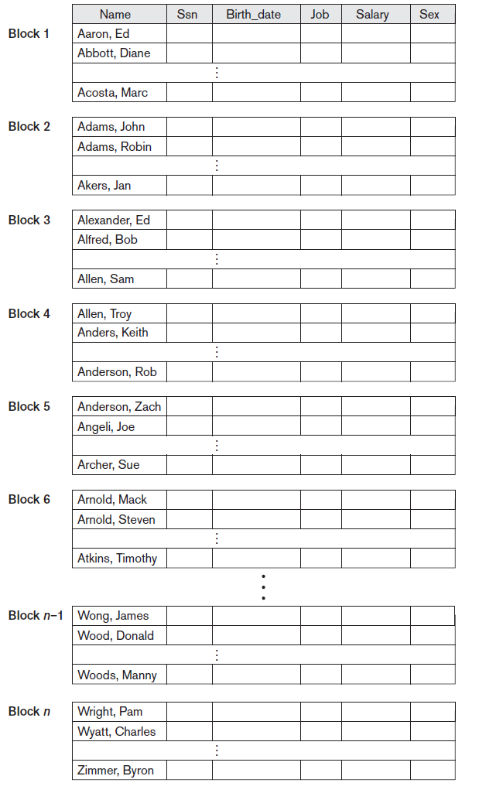

Slide 142
ADVANTAGES
Reading the records in order of the ordering key values becomes extremely efficient because no sorting is required.
Finding the next record from the current one in order of the ordering key usually requires no additional block accesses
Using a search condition based on the value of an ordering key field results in faster access when the binary search technique is used

Slide 143
DISADVANTAGE
Inserting and deleting records are expensive operations for an ordered file because the records must remain physically ordered.
For record deletion, the problem is less severe if deletion markers and periodic reorganization are used

Slide 144
One option for making insertion more efficient is to keep some unused space in each block for new records. However, once this space is used up, the original problem resurfaces.
Another frequently used method is to create a temporary unordered file called an overflow or transaction file.
With this technique, the actual ordered file is called the main or master file.
New records are inserted at the end of the overflow file rather than in their correct position in the main file.

Slide 145
Periodically, the overflow file is sorted and merged with the master file during file reorganization.
Insertion becomes very efficient, but at the cost of increased complexity in the search algorithm.
The overflow file must be searched using a linear search if, after the binary search, the record is not found in the main file.

Slide 146
FILES OF UNORDERED RECORDS(HEAP FILES)
Records are placed in the file in the order in which they are inserted, so new records are inserted at the end of the file. Such an organization is called a heap or pile file.
This organization is often used with additional access paths, such as the secondary indexes

Slide 147
INSERTION: Inserting a new record is very efficient. The last disk block of the file is copied into a buffer, the new record is added, and the block is then rewritten back to disk. The address of the last file block is kept in the file header

Slide 148
SEARCHING:
a linear search
an expensive procedure.
If only one record satisfies the search
condition,then, on the average, requires
searching (b/2)blocks,b number of blocks.
If no records or several records satisfy the search condition, the program must read and search all b blocks in the file

Slide 149
DELETION:a program must first find its block, copy the block into a buffer,delete the record from the buffer, and finally rewrite the block back to the disk. This leaves unused space in the disk block.
Another technique used for record deletion is to have an extra byte or bit, called a deletion marker, stored with each record
Both of these deletion techniques require periodic reorganization of the file to reclaim the unused space of deleted records.

Slide 150
possibility is to use the space of deleted records when inserting new records,
either spanned or unspanned organization for an unordered file
either fixed-length or variable-length records

Slide 151
HASHING
Another type of primary file organization is based on hashing,
This is where a records placement is determined by value in the hash field.
which provides very fast access to records under certain search conditions.
This organization is usually called a hash file
The search condition must be an equality condition on a single field, called the hash field.
In most cases, the hash field is also a key field of the file,in which case it is called the hash key.

Slide 152
The idea behind hashing is to provide a function h, called a hash function or randomizing function, which is applied to the hash field value of a record and yields the address of the disk block in which the record is stored.
Two types of hashing
Internal hashing
External hashing

Slide 153
INTERNAL HASHING
Hashing for internal files
hashing is typically implemented as a hash table through the use of an array of records. Suppose that the array index range is from 0 to M – 1(M number of slots)
a hash function that transforms the hash field value into an integer between 0 and M − 1.
One common hash function is the h(K) = K mod M function, which returns the remainder of an integer hash field value K after division by M; this value is then used for the record address.

Slide 154
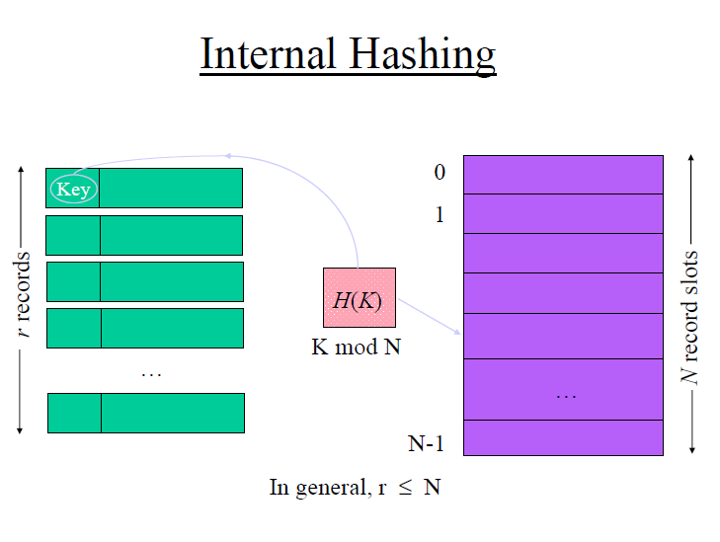

Slide 155
Other hashing function folding
Involves applying an arithmetic function such as addition or a logical function such as exclusive or to different portions of the hash field value to calculate the hash address
A collision occurs when the hash field value of a record that is being inserted hashes to an address that already contains a different record.
In this situation, we must insert the new record in some other position, since its hash address is occupied.
The process of finding another position is called collision resolution.

Slide 156
There are numerous methods for collision resolution, including the following:
■ Open addressing. Proceeding from the occupied position specified by the hash address, the program checks the subsequent positions in order until an unused (empty) position is found.
■ Chaining. For this method, various overflow locations are kept, usually by extending the array with a number of overflow positions.

Slide 157
Additionally, a pointer field is added to each record location.
A collision is resolved by placing the new record in an unused overflow location and setting the pointer of the occupied hash address location to the address of that overflow location.
■ Multiple hashing.
The program applies a second hash function if the first results in a collision. If another collision results, the program uses open addressing or applies a third hash function and then uses open addressing if necessary

Slide 158
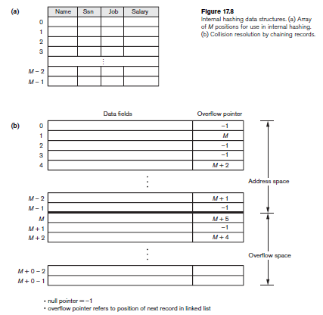

Slide 159
Goals of the Hash Function
The goals of a good hash function are to uniformly distribute the records over the address space while minimizing collisions to avoid wasting space.
Research has shown best to keep a hash table between 70 and 90 percent full so that the number of collisions remains low
we do not waste too much space.

Slide 160
External Hashing for Disk Files (1/7)
Hashing for disk files is called external hashing.
To suit the characteristics of disk storage, the target address space is made of buckets, each of which holds multiple records.
A bucket is either one disk block or a cluster of contiguous blocks.
The hashing function maps a key into a relative bucket number, rather than assign an absolute block address to the bucket.
A table maintained in the file header converts the bucket number into the corresponding disk block address.

Slide 161
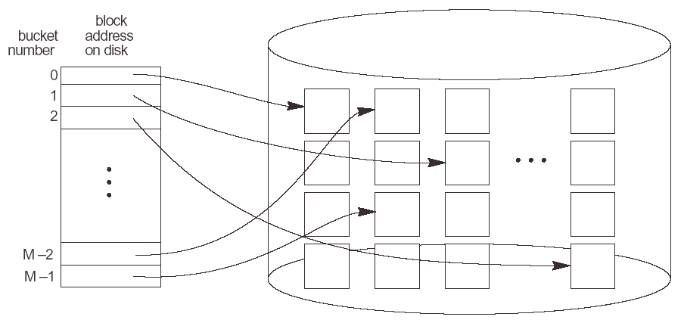

Slide 162
External Hashing for Disk Files (2/7)
The collision problem is less severe with buckets, because as many records as will fit in a bucket can hash to the same bucket without causing problems.
However, we must make provisions for the case where a bucket is filled to capacity and a new record being inserted hashes to that bucket.
We can use a variation of chaining in which a pointer is maintained in each bucket to a linked list of overflow records for the bucket.
The pointers in the linked list should be record pointers, which include both a block address and a relative record position within the block.

Slide 163
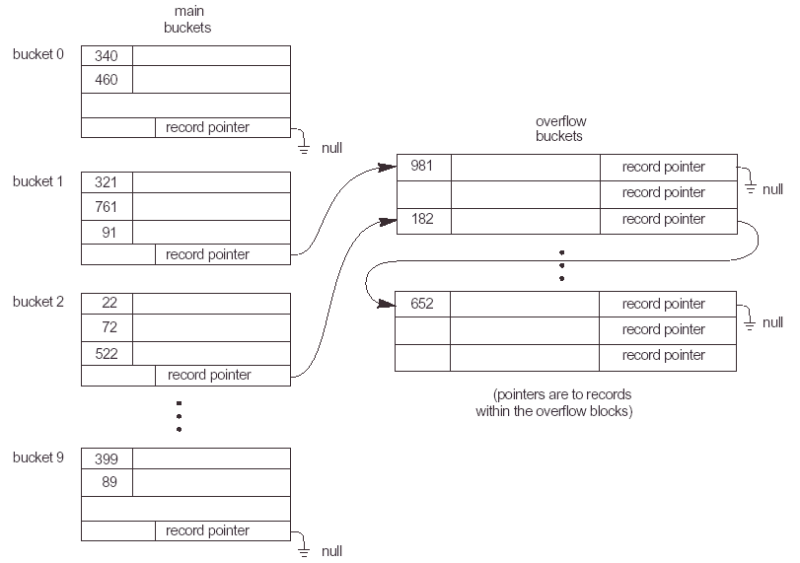

Slide 164
External Hashing for Disk Files (3/7)
Hashing provides the fastest possible access for retrieving an arbitrary record given the value of its hash field.
Although most good hash functions do not maintain records in order of hash field values, some functions—called order preserving—do.

Slide 165
External Hashing for Disk Files (4/7)
The hashing scheme described is called static hashing because a fixed number of buckets M is allocated.
Under Static Hashing a fixed number of buckets (M) is allocated.
Based on the hash value a bucket number is determined in the block directory array which yields the block address.
If m is max no of records fit into each block. This method allows up to m*M records to be stored.
If the number of records turns out to be substantially fewer than (m * M), we are left with a lot of unused space.

Slide 166
External Hashing for Disk Files (5/7)
if the number of records increases to substantially more than (m * M), numerous collisions will result and retrieval will be slowed down because of the long lists of overflow records
In either case, we may have to change the number of blocks M allocated and then use a new hashing function (based on the new value of M) to redistribute the records.
When using external hashing, searching for a record given a value of some field other than the hash field is as expensive as in the case of an unordered file.

Slide 167
External Hashing for Disk Files (6/7)
Record deletion can be implemented by removing the record from its bucket.
If the bucket has an overflow chain, we can move one of the overflow records into the bucket to replace the deleted record.
If the record to be deleted is already in overflow, we simply remove it from the linked list.
Notice that removing an overflow record implies that we should keep track of empty positions in overflow.
This is done easily by maintaining a linked list of unused overflow locations.

Slide 168
External Hashing for Disk Files (7/7)
Modifying a record’s field value depends on two factors: (1) the search condition to locate the record and (2) the field to be modified.
If the search condition is an equality comparison on the hash field, we can locate the record efficiently by using the hashing function; otherwise, we must do a linear search.
A nonhash field can be modified by changing the record and rewriting it in the same bucket.
Modifying the hash field means that the record can move to another bucket, which requires deletion of the old record followed by insertion of the modified record.

Slide 169
Hashing Techniques That Allow Dynamic File Expansion

Slide 170
Extendible Hashing (1/5)
In extendible hashing, a type of directory—an array of 2^{d} bucket addresses—is maintained, where d is called the global depth of the directory.
The integer value corresponding to the first (high-order) d bits of a hash value is used as an index to the array to determine a directory entry, and the address in that entry determines the bucket in which the corresponding records are stored.

Slide 171
Extendible Hashing (2/5)
However, there does not have to be a distinct bucket for each of the 2^{d} directory locations.
Several directory locations with the same first d’ bits for their hash values may contain the same bucket address if all the records that hash to these locations fit in a single bucket.
A local depth d’—stored with each bucket—specifies the number of bits on which the bucket contents are based.
Figure below shows global depth=3

Slide 172
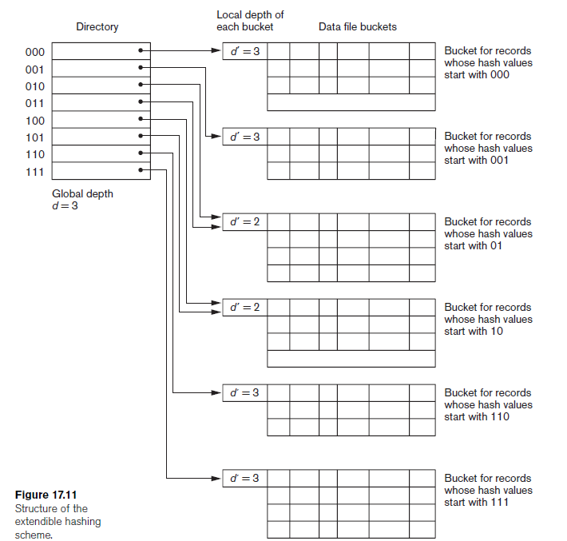

Slide 173
Extendible Hashing (3/5)
The value of d can be increased or decreased by one at a time, thus doubling or halving the number of entries in the directory array.
Doubling is needed if a bucket, whose local depth d’ is equal to the global depth d, overflows.
Halving occurs if d > d’ for all the buckets after some deletions occur.

Slide 174
Extendible Hashing (4/5)
ADVANTAGE
The main advantage of extendible hashing that makes it attractive is that the performance of the file does not degrade as the file grows.
In addition, no space is allocated in extendible hashing for future growth, but additional buckets can be allocated dynamically as needed.
The space overhead for the directory table is negligible.
The maximum directory size is 2^{k}, where k is the number of bits in the hash value.
Another advantage is that splitting causes minor reorganization in most cases, since only the records in one bucket are redistributed to the two new buckets.
The only time a reorganization is more expensive is when the directory has to be doubled (or halved).

Slide 175
Extendible Hashing (5/5)
A disadvantage is that the directory must be searched before accessing the buckets themselves, resulting in two block accesses instead of one in static hashing.
This performance penalty is considered minor and hence the scheme is considered quite desirable for dynamic files.

Slide 176
Linear Hashing (1/9)
The idea behind linear hashing is to allow a hash file to expand and shrink its number of buckets dynamically without needing a directory.

Slide 177
Linear Hashing (2/9)
Suppose that the file starts with M buckets numbered 0, 1, . . . , M - 1 and uses the mod hash function h(K) = K mod M; this hash function is called the initial hash function .
Overflow because of collisions is still needed and can be handled by maintaining individual overflow chains for each bucket.

Slide 178
Linear Hashing (3/9)
However, when a collision leads to an overflow record in any file bucket, the first bucket in the file—bucket 0—is split into two buckets: the original bucket 0 and a new bucket M at the end of the file.
The records originally in bucket 0 are distributed between the two buckets based on a different hashing function h_{i+1} (K) = K mod 2M.
A key property of the two hash functions h_{i} and h_{i+1} is that any records that hashed to bucket 0 based on h_{i} will hash to either bucket 0 or bucket M based on h_{i+1}; this is necessary for linear hashing to work.

Slide 179
Linear Hashing (4/9)
As further collisions lead to overflow records, additional buckets are split in the linear order 1, 2, 3, . . . .
If enough overflows occur, all the original file buckets 0, 1, . . . , M - 1 will have been split, so the file now has 2M instead of M buckets, and all buckets use the hash function.
Hence, the records in overflow are eventually redistributed into regular buckets, using the function h_{i+1} via a delayed split of their buckets.

Slide 180
Linear Hashing (5/9)
There is no directory; only a value n—which is initially set to 0 and is incremented by 1 whenever a split occurs—is needed to determine which buckets have been split.
To retrieve a record with hash key value K, first apply the function h_{i} to K; if h_{i} (K) < n, then apply the function h_{i+1} on K because the bucket is already split.
Initially, n = 0, indicating that the function h_{i} applies to all buckets; n grows linearly as buckets are split.

Slide 181
Linear Hashing (6/9)
When n = M after being incremented, this signifies that all the original buckets have been split and the hash function applies to all records in the file.
At this point, n is reset to 0 (zero), and any new collisions that cause overflow lead to the use of a new hashing function h_{i+2} (K) = K mod 4M.

Slide 182
Linear Hashing (7/9)
Splitting can be controlled by monitoring the file load factor instead of by splitting whenever an overflow occurs.
In general, the file load factor l can be defined as l = r/(bfr * N), where r is the current number of file records, bfr is the maximum number of records that can fit in a bucket, and N is the current number of file buckets.

Slide 183
Linear Hashing (8/9)
Buckets that have been split can also be recombined if the load of the file falls below a certain threshold.
Blocks are combined linearly, and N is decremented appropriately.

Slide 184
Linear Hashing (9/9)
The file load can be used to trigger both splits and combinations; in this manner the file load can be kept within a desired range.
Splits can be triggered when the load exceeds a certain threshold—say, 0.9—and combinations can be triggered when the load falls below another threshold—say, 0.7.

Slide 185
Indexes as Access Paths
A single-level index is an auxiliary file that makes it more efficient to search for a record in the data file.
The index is usually specified on one field of the file (although it could be specified on several fields) called indexing field
One form of an index is a file of entries <field value, pointer to record>, which is ordered by field value
two field values of index entry i as <K(i), P(i)>.
The index is called an access path on the field.

Slide 186
Indexes as Access Paths (contd.)
The values in the index are ordered so that we can do a binary search on the index.
The index file usually occupies considerably less disk blocks than the data file because its entries are much smaller
Indexes can also be characterized as dense or sparse.
A dense index has an index entry for every search key value (and hence every record) in the data file.
A sparse (or nondense) index, on the other hand, has index entries for only some of the search values

Slide 187
Dense Index Files
Dense index – index record appears for every search-key value in the file.

Slide 188
Example of Sparse Index Files

Slide 189
Indexing Structures for Files
Types of Single-level Ordered Indexes
Primary Indexes
Clustering Indexes
Secondary Indexes
Multilevel Indexes
Dynamic Multilevel Indexes Using B-Trees and B+-Trees
Indexes on Multiple Keys

Slide 190
Types of Single-Level ordered Indexes
Primary Index
Defined on an ordered data file
The data file is ordered on a key field
Includes one index entry for each block in the data file;
<K(1) = (Aaron, Ed), P(1) = address of block 1>
<K(2) = (Adams, John), P(2) = address of block 2>
<K(3) = (Alexander, Ed), P(3) = address of block 3>
The total number of entries in the index is the same as the number of disk blocks in the ordered data file.

Slide 191
The first record in each block of the data file is called the anchor record of the block, or simply the block anchor
A primary index is a nondense (sparse) index, since it includes an entry for each disk block of the data file and the keys of its anchor record rather than for every search value.

Slide 192
a binary search on the index file requires fewer block accesses than a binary search on the data file
DISADVATAGE:
insertion and deletion of records
we attempt to insert a record in its correct position in the data file, we must not only move records to make space for the new record but also change some index entries,
since moving records will change the anchor records of some blocks..
SOLVE by using unordered OF file,LINKED file
Deletion by deletion marker

Slide 193
rollno | Name | age
1
2
3
Block anchor | Block pointer
1
4
7
rollno | name | age
4
5
6
rollno | name | age
7
8
9

Slide 194
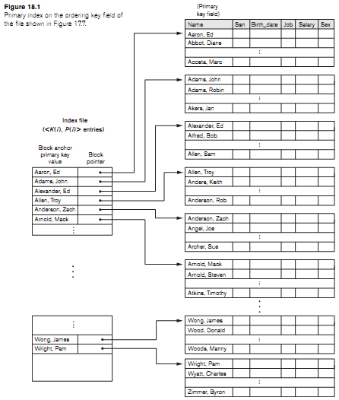

Slide 195
Types of Single-Level Indexes
Clustering Index
Defined on an ordered data file
The data file is ordered on a non-key field unlike primary index, which requires that the ordering field of the data file have a distinct value for each record.
Includes one index entry for each distinct value of the field; the index entry points to the first data block that contains records with that field value.
It is another example of nondense index where Insertion and Deletion is relatively straightforward with a clustering index.

Slide 196
rollno | Name | age
1
1
2
Block anchor | Block pointer
1
2
3
4
rollno | name | age
2
2
3
rollno | name | age
3
3
4

Slide 197
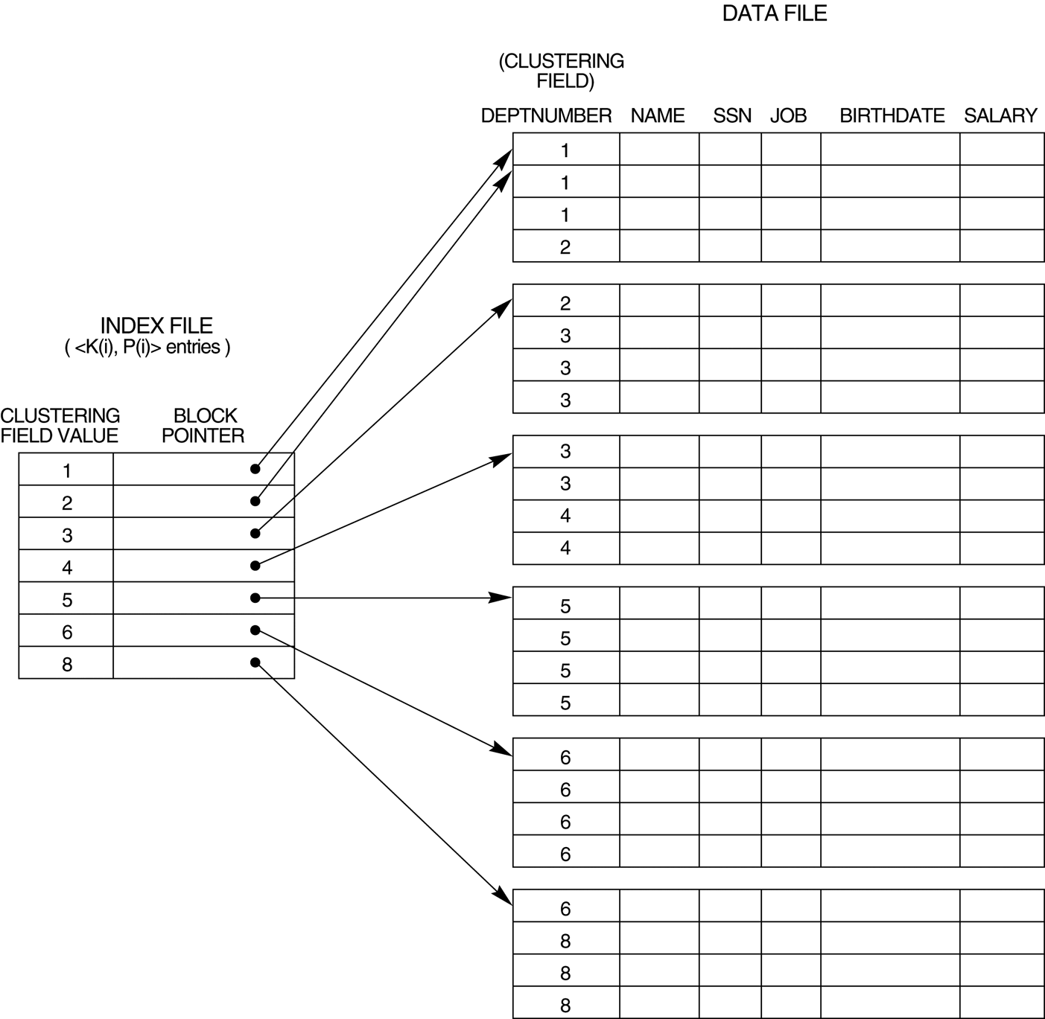
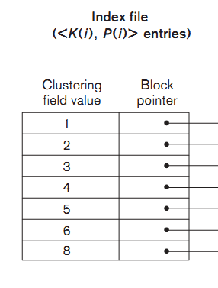

Slide 198
record insertion and deletion still cause problems because the data records are physically ordered.
To solve the problem of insertion, it is common to reserve a whole block

Slide 199
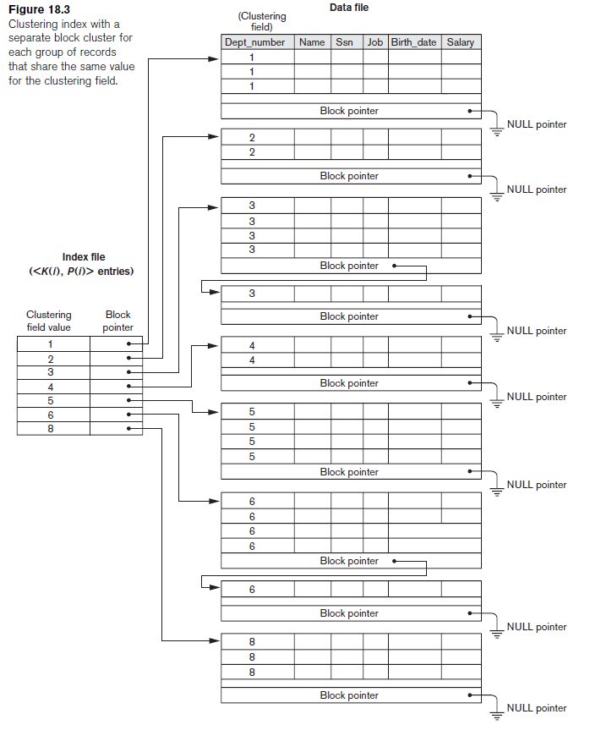

Slide 200
Types of Single-Level Indexes
Secondary Index
A secondary index provides a secondary means of accessing a file for which some primary access already exists.
The data file records could be ordered,unordered, or hashed.
The secondary index may be on a field which is a candidate key and has a unique value in every record, or a nonkey with duplicate values.
The index is an ordered file with two fields.
The first field is of the same data type as some nonordering field of the data file that is an indexing field
The second field is either a block pointer or a record pointer. There can be many secondary indexes (and hence, indexing fields) for the same file.

Slide 201
Includes one entry for each record in the data file; hence, it is a dense index
A secondary index usually needs more storage space and longer search time than does a primary index, because of its larger number of entries.

Slide 202
rollno | Name | Age
1
4
5
Indexfield value | Block pointer
1
4
5
7
28
21
32
42
rollno | Name | age
7
28
21
Rollno | Name | age
32
42

Slide 203
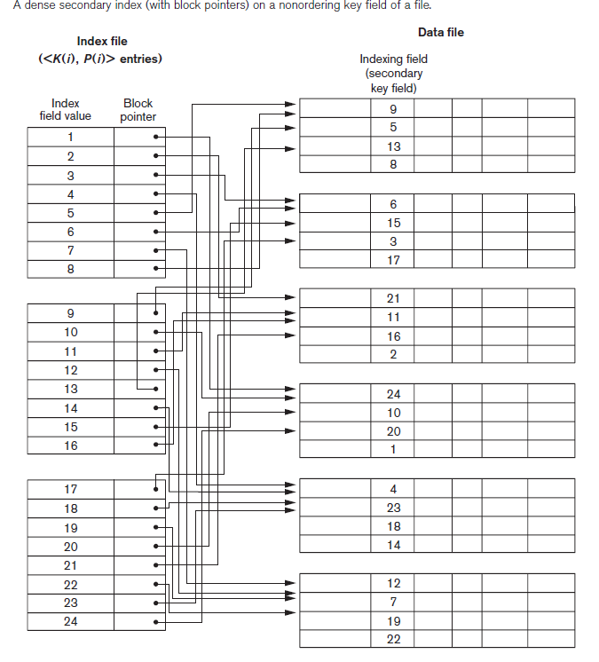

Slide 204
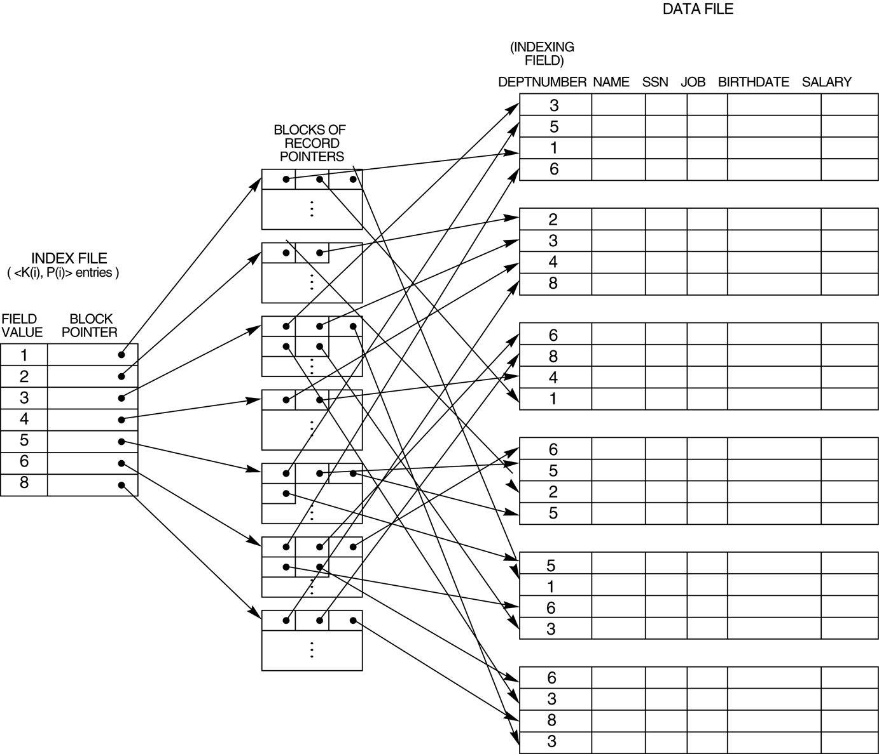
A secondary index (with recored pointers) on a nonkey field implemented using one level of indirection so that index entries are of fixed length and have unique field values.

Slide 205
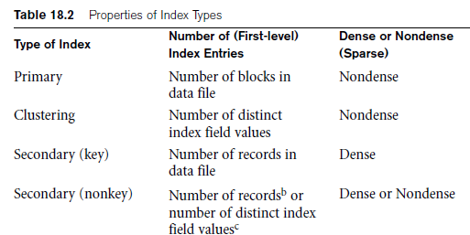

Slide 206
Multi-Level Indexes
Because a single-level index is an ordered file, we can create a primary index to the index itself ; in this case, the original index file is called the first-level index and the index to the index is called the second-level index.
We can repeat the process, creating a third, fourth, ..., top level until all entries of the top level fit in one disk block
A multi-level index can be created for any type of first-level index (primary, secondary, clustering) as long as the first-level index consists of more than one disk block

Slide 207
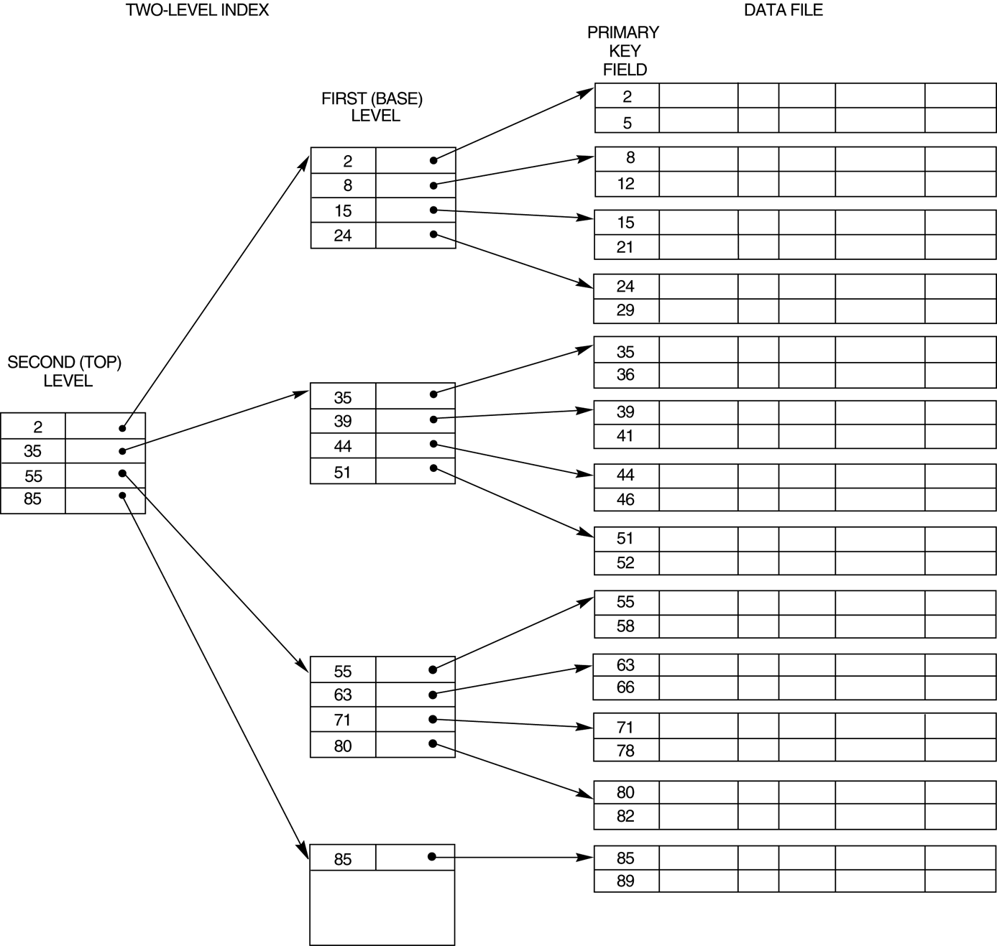
A two-level primary index resembling ISAM (Indexed Sequential Access Method) organization

Slide 208
a multilevel index reduces the number of blocks accessed when searching for a record, given its indexing field value.
index insertions and deletions problem , because all index levels are physically ordered files
reducing index insertion and deletion problems, designers adopted a multilevel index called a dynamic multilevel index .

Slide 209
Dynamic Multi-Level Indexes
To retain the benefits of using multilevel indexing while reducing index insertion and deletion problems
Leaves some space in each of its blocks for inserting new entries and uses appropriate insertion/deletion algorithms for creating and deleting new index blocks when the data file grows and shrinks.
Often implemented by using data structures called B-trees and B+-trees

Slide 210
B-trees and B+-trees are special cases of the well-known search data structure known as a tree.
A tree is formed of nodes.
Each node in the tree, except for a special node called the root, has one parent node and zero or more child nodes.
The root node has no parent. A node that does not have any child nodes is called a leaf node;
a nonleaf node is called an internal node.
The level of a node is always one more than the level of its parent, with the level of the root node being zero.
A subtree of a node consists of that node and all its descendant nodes

Slide 211
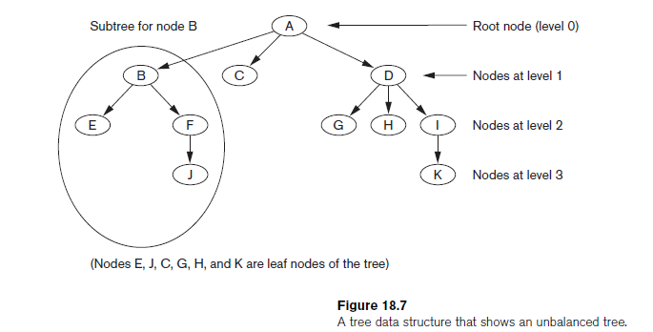
In this figure the root node is A, and its child nodes are B, C, and D. Nodes E, J, C, G, H, and K are leaf nodes.
Since the leaf nodes are at different levels of the tree, this tree is called unbalanced.

Slide 212
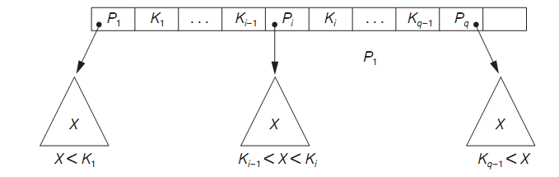
Search Tree
A search tree of order p is a tree such that each node contains at most p − 1 search values and p pointers in the order <P1, K1, P2, K2, ..., Pq−1, Kq−1, Pq>, where q ≤ p. Each Pi is a pointer to a child node (or a NULL pointer), and each Ki is a search value from some ordered set of values. All search values are assumed to be unique

Slide 213

A search tree of order p = 3.

Slide 214
Dynamic Multilevel Indexes Using B-Trees and B+-Trees
Because of the insertion and deletion problem, most multi-level indexes use B-tree or B+-tree data structures, which leave space in each tree node (disk block) to allow for new index entries
These data structures are variations of search trees that allow efficient insertion and deletion of new search values.
In B-Tree and B+-Tree data structures, each node corresponds to a disk block
Each node is kept between half-full and completely full

Slide 215
Dynamic Multilevel Indexes Using B-Trees and B+-Trees (contd.)
An insertion into a node that is not full is quite efficient; if a node is full the insertion causes a split into two nodes
Splitting may propagate to other tree levels
A deletion is quite efficient if a node does not become less than half full
If a deletion causes a node to become less than half full, it must be merged with neighboring nodes

Slide 216
Difference between B-tree and B+-tree
In a B-tree, pointers to data records exist at all levels of the tree
In a B+-tree, all pointers to data records exists at the leaf-level nodes
A B+-tree can have less levels (or higher capacity of search values) than the corresponding B-tree

Slide 217


Slide 218


Slide 219
MODULE 3

